Slide 1
JobSeeker Payment
Understanding economic and policy trends affecting Commonwealth expenditure
Kathryn Smith and Binod Nepal
Parliamentary Budget Office
www.pbo.gov.au
Australian Conference of Economists
14 July 2021

Slide 2
Overview
Applied research on trends in JobSeeker Payment recipients and expenditure
  to inform PBO’s medium-term projections models
Exploits de-indentified unit record data to examine trends in recipients & their drivers
We find trends in recipient population composition, duration on payment and capacity to work
  may mean economic conditions have less effect on the employment outcomes of recipients
Updated projections model incorporates age and gender variation

Slide 3



What is the PBO?
We aim to assist all parliamentarians
to better understand
budget issues and the
budget implications
of policies they may
be considering
The PBO is an independent and
non-partisan department of the Parliament
We undertake
objective analysis;
we do not provide policy advice or
recommendations

Slide 4
Research questions, data & approach

Slide 5
Objectives and scope
Motivation: understand historical trends in JobSeeker recipients and expenditure to inform projections of Commonwealth Government expenditure on the JobSeeker payment over the medium term.
Research questions
  Is the connection between unemployment benefits and unemployment changing?
  Have the characteristics of the JobSeeker population changed over time? If so, how and what are the drivers?
  What (if any) are the implications for future spending on the program?
Scope: fiscal considerations relating to unemployment benefits

Slide 6
Data sources
Published aggregate statistics
  DSS payment demographic data (data.gov.au)
  Labour Market and Related Payments Monthly Profile publications (dss.gov.au)
  DSS annual reports; Budget papers
  ABS population/Labour force statistics
Department of Social Services (DSS) de-identified unit record payment data
  ‘Bluebook’ dataset: snapshots at the last Friday of each month
  Official source for most published DSS statistics
  June snapshots from 2001 to 2019
  Similar information in DOMINO and MADIP

Slide 7
What is JobSeeker Payment?

Slide 8
Payment overview
Main income support payment for job seekers aged 22 to under Age Pension age with capacity to work
Replaced Newstart from 20 March 2020 with basic rates & eligibility unchanged
Means- and activity-tested
Indexed by the CPI in March and September
Temporary COVID-19 measures included Coronavirus Supplement
$50/fortnight increase in base rate from 1 April 2021
Averages around 6% of Commonwealth Government social security and welfare spending, higher in economic crises

Slide 9
JobSeeker recipients can be unemployed, underemployed or not in the labour force
Receiving
JobSeeker &
unemployed
Receiving JobSeeker;
Either Employed, underemployed or Not in Labour Force (ABS)
Unemployed (ABS);
Not receiving JobSeeker
Note: not to scale; see PBO JobSeeker paper p.7 for more information

Slide 10
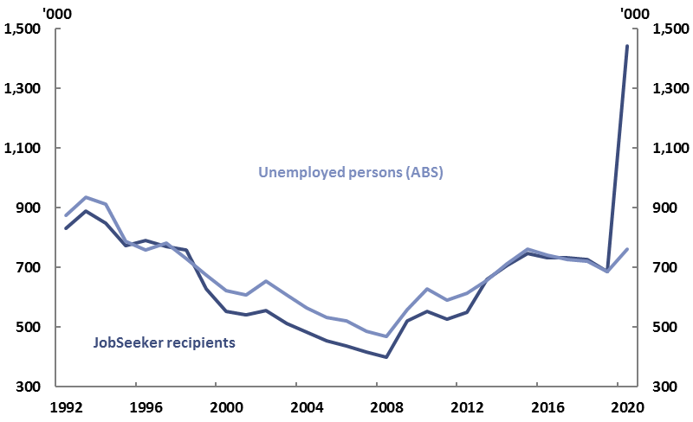
Historically the relationship between unemployment levels and benefits has been quite close in aggregate
JobSeeker recipients and unemployed persons, 1992 to 2020
Note: unemployed persons are averages of monthly counts (seasonally adjusted) over the year to June. The minimum age of unemployed persons is lower than minimum age of JobSeeker recipients; see Appendix A for a figure including recipients of Youth Allowance (unemployed). Recipient data in ABS year books were sourced from government departments.
Source: DSS Payment Demographic Data, ABS year books (cat no. 1301.0), ABS labour force (cat no. 6202.0) and PBO analysis

Slide 11
Changing composition of the JobSeeker population:
trends & drivers

Slide 12
Three broad trends over time
JobSeeker recipients’ demographics have changed significantly,
  From mostly younger men to older people, increasingly older women
The share of longer-term JobSeeker recipients is rising
The shares of recipients searching for work and assessed as having full capacity for work are falling

Slide 13
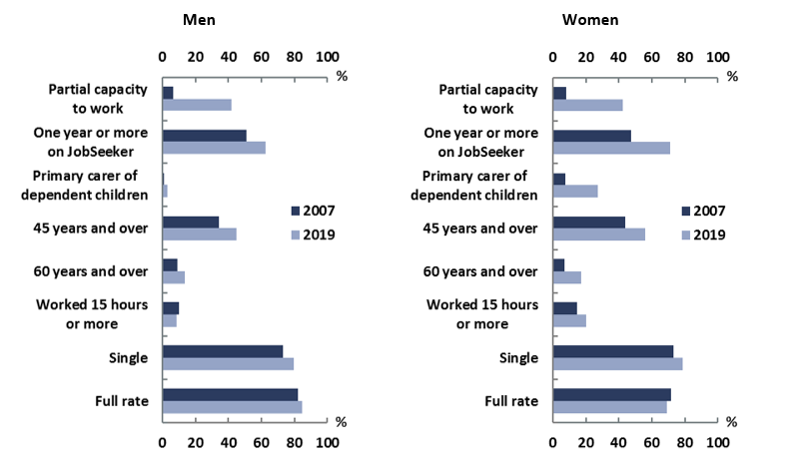
Characteristics of JobSeeker recipients have changed
JobSeeker recipients by selected characteristics, 2007 and 2019
Note: ‘Partial capacity to work’ refers to activity tested recipients having an assessed physical, intellectual or psychiatric impairment, which would prevent them from working 30 hours per week. ‘Primary carer of dependent children’ relates to children under 16. ‘Worked 15 hours or more’ refers to 15 hours or more from all jobs in the last fortnight. Figures are as at June each year.
Source: PBO analysis of DSS Bluebook, a de-identified administrative dataset. References to Bluebook throughout this report are to point-in-time snapshots in June.

Slide 14
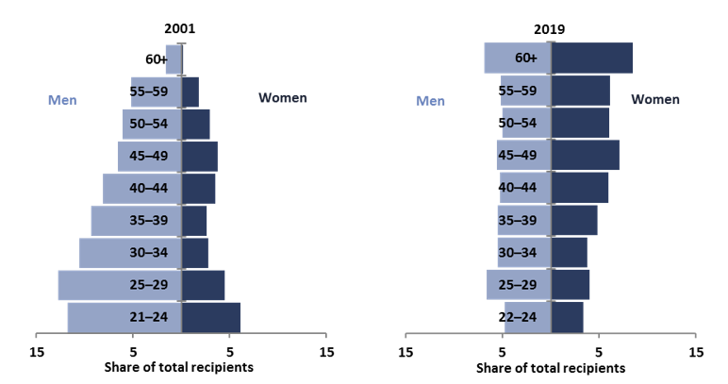
Recipients by age and gender: from pyramid to coffin?
Share of JobSeeker recipients by gender and age group, 2001 and 2019
Note: ‘60+’ category comprises 60 to under 62 years for women and under 65 years for men in 2001, and under 66 for both genders in 2019. The age pension qualifying age was 61.5 years for females and 65 years for males in June 2001 and 65.5 years for both genders in June 2019. Figures are as at June.
Source: PBO analysis of DSS Bluebook.

Slide 15
Policy changes have played a major role
Policy changes affecting JobSeeker payment relate mainly to other payments
Modification in eligibility requirements for four income support payments have increased the likelihood that recipients are on JobSeeker
Three of the four major changes over the past two decades have affected men and women differently
  Closure of ‘partner payments’
  Increase in the age pension age from 60-65 for women over 1995 to 2013 (from 65 to 67 for both genders over 2017 to 2023)
  Changes to parenting payment in 2006 and removal of legacy arrangements in 2013
Changes to Disability Support Pension eligibility 2012 to 2015 affect both genders

Slide 16
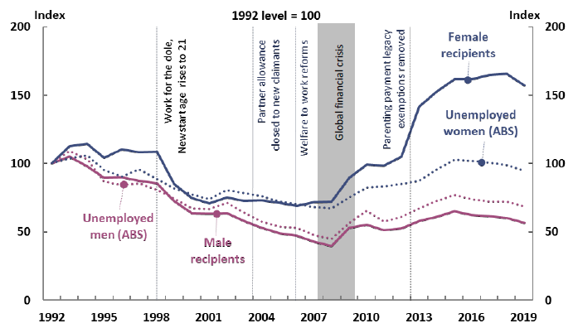
Some policy changes have affected men and women differently
JobSeeker recipients and unemployed persons by gender, 1992 to 2019; key economic and policy changes
Note: Data on JobSeeker recipients are as at June except for 2000 which are as at May. Data on unemployment are averages of seasonally adjusted monthly data over the year from July to June.
Source: DSS Payment Demographic Data, ABS year books (cat no. 1301.0), ABS labour force (cat no. 6202.0) and PBO analysis.

Slide 17
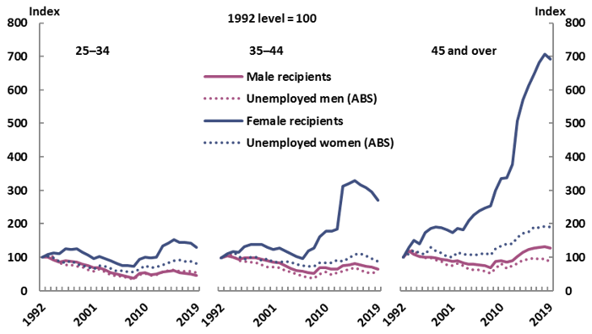
Many more older women receive JobSeeker than are unemployed
JobSeeker recipients and unemployed persons by gender and age, 1992 to 2019
Note: Data on JobSeeker are as at June except for the year 2000 which are as at May. Data on unemployment are averages of original monthly data over the year July to June. JobSeeker data to 2013 are from DSS Payment Demographic Data; JobSeeker data from 2014 to 2019 are sourced from DSS Bluebook. ’45 and over’ refers to 45–64 for unemployment data.
Source: DSS Payment Demographic Data, ABS year books (cat no. 1301.0), ABS labour force (cat no. 6291.0.55.001), DSS Bluebook and PBO analysis.

Slide 18
The share of longer-term JobSeeker recipients is rising, particularly amongst older women
Recipients on JobSeeker for five years or more, share of all JobSeeker recipients by gender and age, 2007 to 2019
Source: PBO analysis of DSS Bluebook.

Slide 19
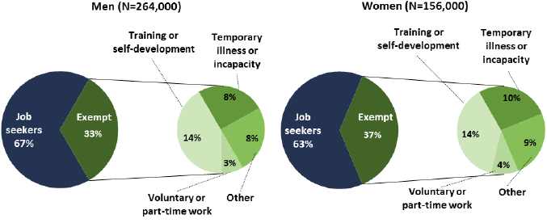
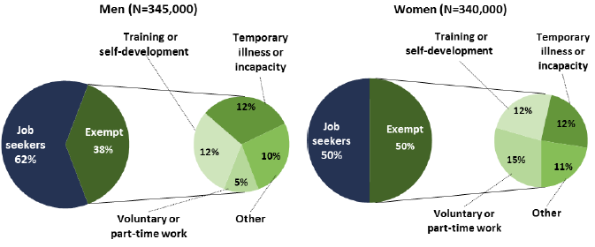
Almost half of all JobSeeker recipients are not required to search for jobs
Job search and conditions for exemptions by gender, 2007 and 2019
June 2007
June 2019
Source: DSS Labour Market and Related Payments: a monthly profile, June 2007 and June 2019, and PBO analysis.

Slide 20
40% of JobSeeker recipient assessed as having partial capacity to work in 2019, up from 10% in 2007
JobSeeker recipients by selected characteristics, 2007 and 2019
Note: ‘Partial capacity to work’ refers to activity tested recipients having an assessed physical, intellectual or psychiatric impairment, which would prevent them from working 30 hours per week. ‘Primary carer of dependent children’ relates to children under 16. ‘Worked 15 hours or more’ refers to 15 hours or more from all jobs in the last fortnight. Figures are as at June each year.
Source: PBO analysis of DSS Bluebook, a deidentified administrative dataset. References to Bluebook throughout this report are to point-in-time snapshots in June.

Slide 21
Budget implications over the medium term

Slide 22
Implications for future spending
Major trends before the pandemic mean the JobSeeker recipient population different from that during previous recessions
  the increasing share of women and older recipients
  a growing reliance on JobSeeker for longer periods, particularly among older age groups
  a falling share of recipients with full capacity to work.
The rise of long-term recipients, older recipients and women recipients is likely to continue irrespective of short-term fluctuations in unemployment.
  can place an upward pressure on JobSeeker expenditure, other things equal.
Updated PBO medium-term projections incorporate age- and gender-specific responsiveness of unemployment benefits to unemployment rates

Slide 23
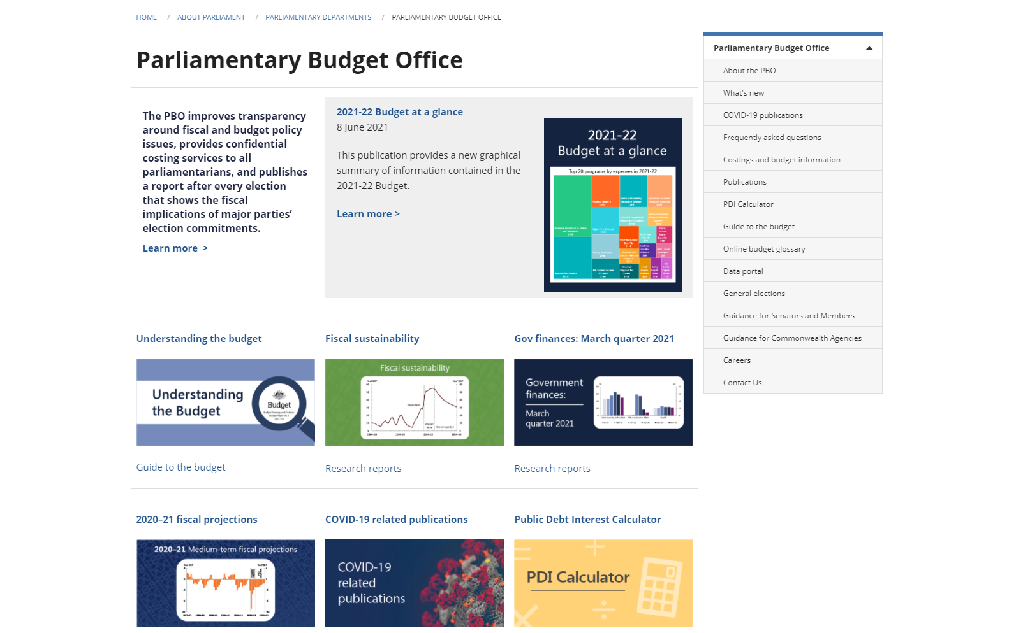
More budget research, data and tools on our website

Slide 24
PO Box 6010
Parliament House
CANBERRA ACT 2600
Phone: 02 6277 9500
Email: pbo@pbo.gov.au

