Slide 1
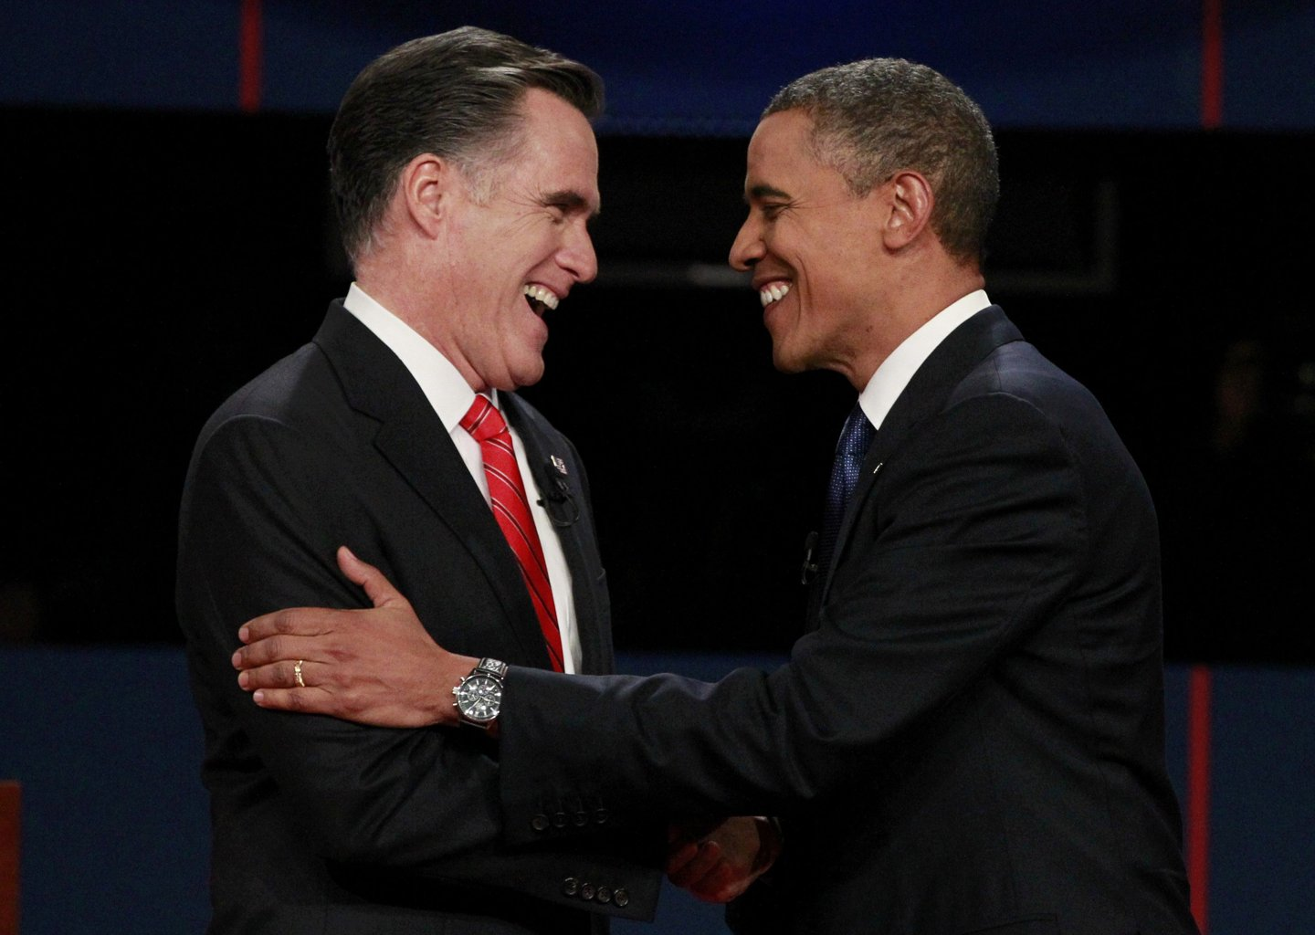
The U.S. Presidential
Election of 2012

Slide 2
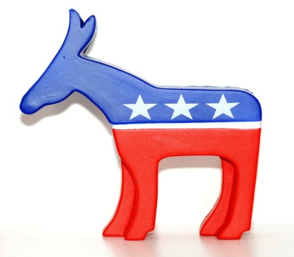
U.S. Presidential Election 2012
Popular Vote Electoral Vote
Barack Obama 62,611,250 (50.6%) 332 (61.7%)
Mitt Romney 59,134,475 (47.8%) 206 (38.3%)
Others 1,968,682 ( 1.6%) 0
Margin of Victory +3,476,775 (+2.8%)
N.B. These figures are based on the incomplete nationwide popular vote total as of 28/11/2012 and are not the final vote totals

Slide 3
Last 14 Presidential Elections by Closeness of Popular Vote
Year Winner Two-Party Popular
Vote Margin
2000 G.W. Bush - 0.5%
1960 Kennedy +0.3%
1968 Nixon +0.5%
1976 Carter +2.1%
2004 G.W. Bush +2.4%
2012 Obama +2.8%
1992 Clinton +5.5%
2008 Obama +7.2%
1988 G.H.W. Bush +7.7%
1996 Clinton +8.5%
1980 Reagan +9.7%
1984 Reagan +18.2%
1964 Johnson +22.6%
1972 Nixon +23.2%

Slide 4
U.S. Presidential Election 2012 – Voting Turnout
Total Votes Cast
2008 131,296,985
2012 123,714,407
Difference -7, 582,578
N.B. These figures are based on the incomplete nationwide popular vote total as of 28/11/2012
And are not the final vote totals.

Slide 5
U.S. Presidential Election 2012 – Exit Polls
Vote by Gender
Male Romney 52% (47% of voters)
Female Obama 55% (53% of voters)
Data from New York Times Exit Poll at http://elections.nytimes.com/2012/results/president/exit-polls

Slide 6
U.S. Presidential Election 2012 – Exit Polls
Vote by Race
White Romney 59% (72% of voters)
Black Obama 93% (13% of voters)
Hispanic Obama 71% (10% of voters)
Asian Obama 73% ( 3% of voters)
Data from New York Times Exit Poll at http://elections.nytimes.com/2012/results/president/exit-polls

Slide 7
U.S. Presidential Election 2012 – Exit Polls
Vote by Age
18-29 Obama 60% (66% in 2008)
30-44 Obama 52%
45-64 Romney 51%
65 and over Romney 56%
Data from New York Times Exit Poll at http://elections.nytimes.com/2012/results/president/exit-polls

Slide 8
U.S. Presidential Election 2012 – Exit Polls
Vote by Income
Under $30000 Obama 63% (20% of voters)
$30k-$44k Obama 57% (21% of voters)
$50k-$99k Romney 53% (31% of voters)
$100k+ Romney 54% (28% of voters)
Data from New York Times Exit Poll at http://elections.nytimes.com/2012/results/president/exit-polls

Slide 9
U.S. Presidential Election 2012 – Exit Polls
Vote by Party Identification
Democrats Obama 92% (38% of voters)
Republicans Romney 93% (32% of voters)
Independents Romney 51%
Obama 45% (29% of voters)
Others 4%
Data from New York Times Exit Poll at http://elections.nytimes.com/2012/results/president/exit-polls

Slide 10
U.S. Presidential Election 2012 – Exit Polls
Vote by Religion
Obama Romney
Protestant 42% 57%
Catholic 50% 48%
Jewish 69% (84% in 2008) 30% (26% in 2008)
Data from Washington Post Exit Poll at http://www.washingtonpost.com/wp-srv/special/politics/2012-exit-polls/table.html

Slide 11
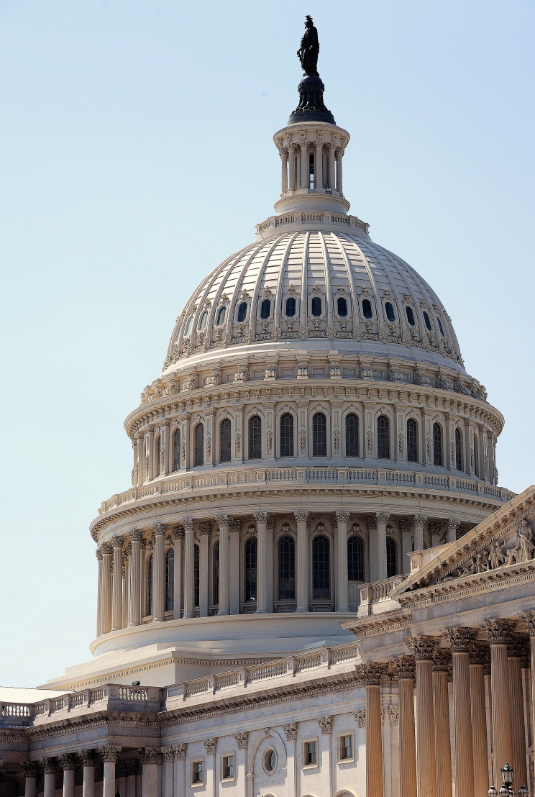
Congressional Races
House of Representatives
Republicans 234 (net loss of 6 seats)
Democrats 200 (net gain of 12 seats)
To be decided 7
Senate
Democrats 53 (net gain of 2 seats)
Republicans 45 (net loss of 2 seats)
Independents 2
N.B. These figures are based on the seat decided as of 28/11/2012.

Slide 12
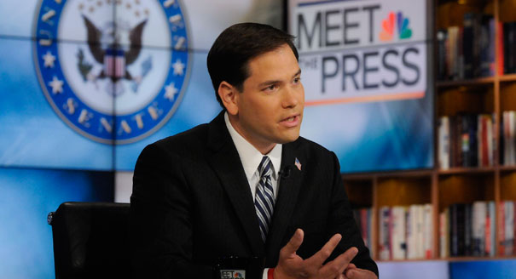
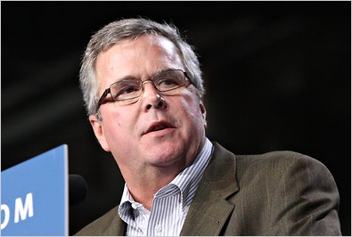
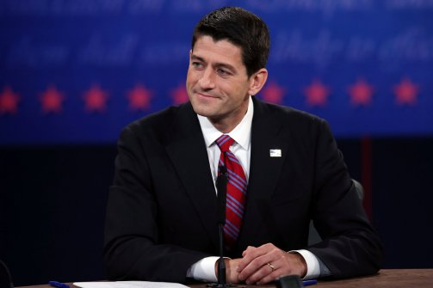
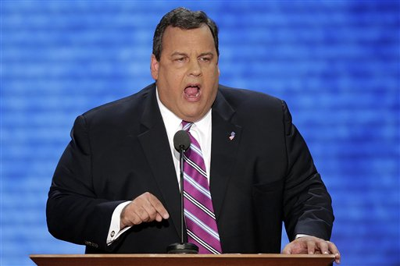
Republicans in 2016?
Jeb Bush
Marco Rubio
Marco Rubio
Chris Christie
Paul Ryan

Slide 13
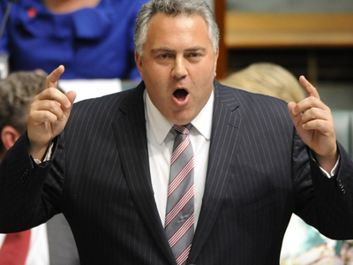
Republicans in 2016?
Jeb Bush
Marco Rubio
Marco Rubio
Chris Christie
Paul Ryan

Slide 14
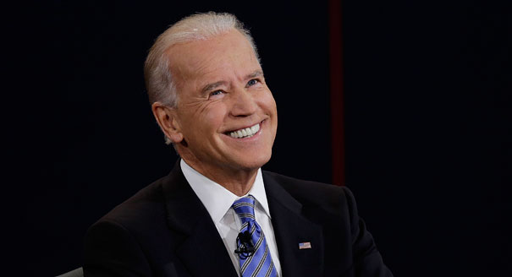
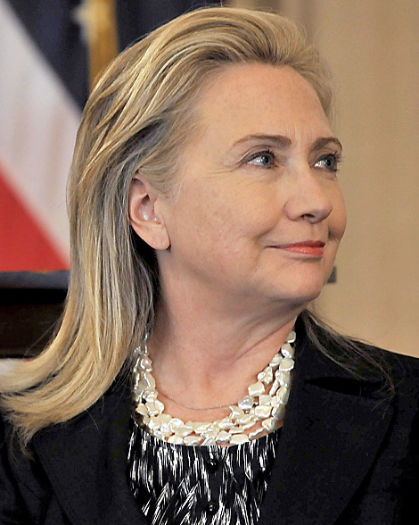
Democrats in 2016?
Joe Biden
Hillary Clinton
Andrew Cuomo

