Slide 1
Budget 2013-14
Daniel Weight
&
Robert Dolamore

Slide 2
Some thoughts on assessing the quality of budgets

Slide 3
Some starting propositions
Budgets are central to the compact between the community & the State
Strong public finances are needed to provide a good foundation for growth
Budgets should be the catalyst for an informed debate about the state of public finances
A Budget is more than the bottom line

Slide 4
What do we mean by ‘quality’
The Budget funds public goods, services & transfers that improve community wellbeing in an efficient way
Having regard for the Government’s priorities the Budget allocates funding to its most efficient use
The Budget is capable of raising the revenue needed to fund government expenditure and in a way that is least detrimental to economic growth and equity

Slide 5
What we mean by ‘quality’ con’t
The Budget includes hard decisions when adjustment is needed
The Budget supports higher and more stable economic growth
Decisions in the Budget are sustainable

Slide 6
A related concept - sustainability
Solvency – the ability of the gov’t to pay its financial obligations
Growth – fiscal policy that sustains economic growth
Stability – the capacity of gov’t to pay current obligations with existing tax burdens
Fairness – the capacity of gov’t to pay current obligations without shifting the cost to future generations
Resilience – the capacity to ‘take a hit’

Slide 7
What can help us assess quality?
Strategy
History
Context
Assumptions
Allocation
Incentives
The Future
Evidence

Slide 8
Strategy
Is the Budget anchored in a credible medium-term fiscal strategy?
Is the Budget linked to some broader economic strategy?
Is the Budget & individual measures consistent with this strategy?
How well does the Budget tell this story?

Slide 9
History
Given the recent past – how realistic is the Budget?
How have key areas of expenditure and revenue been growing?
How does this compare to the projections in the Budget?
What has been tried before and what have we learnt?
What is genuinely new and what is being
‘re-badged’ or ‘re-packaged’?

Slide 10
Context
What is the international economic context?
What is the domestic economic context?
Are there pressing social & environmental issues?
What opportunities & risks fall out of this assessment?
How well does the Budget manage these opportunities and risks?

Slide 11
Assumptions
The Budget is underpinned by forecasts of key economic parameters
How accurate have forecasts in recent Budgets been?
How credible are the forecasts in the current Budget?
How sensitive are the Budget numbers to changes in the key parameters?

Slide 12
Allocation
Budgeting is an inherently allocative process
To what extent does the Budget change the allocation of gov’t funding or the revenue raising burden?
What are the implications for equity, efficiency & effectiveness?
What trade-offs are being made?

Slide 13
Incentives
Through the Budget governments can reshape the incentives we face
How and to what extent does the Budget
re-shape incentives?
  Including - to work, spend, save and invest?
How is this likely to impact on economic growth & budget sustainability?

Slide 14
The future
What are the long-term implications for the Budget of:
  new spending measures or spending cuts
  new revenue measures or tax cuts?
Do they make the Budget more ‘pro-cyclical’ or less?
What costs are being shifted onto future generations?
How well does the Budget address long-term challenges?

Slide 15
Evidence
What is the evidence base for the decisions taken in the Budget?
To what extent have program evaluations & reviews informed spending decisions?
If a measure is more of an ‘informed experiment’ will it be subject to an independent evaluation?

Slide 16
Some closing questions
How good has the Budget process been?
Is the material well presented and transparent?
What has been left for another day?

Slide 17
An overview of the
Budget Papers

Slide 18
What affects the fiscal position?
Parameter variations
  On the revenue side, tax and other receipts are affected by underlying economic activity
    Corporate profits
    Employment
  On the expenditure side, many government expenditures are demand driven
    Unemployment benefits
    Medicare
    Budget measures
  Decision by government to spend or save
    Changing program eligibility
    Changing tax rules

Slide 19
What affects the fiscal position?

Slide 20
Annual Budget: who is the audience?
Parliamentarians
Media
General public and interest groups
Economists and business
Commonwealth government
State/Territory Governments

Slide 21
GFS sectoral classifications
General Government Sector (GGS)
  Government departments
  Expenditure programs
  Statutory authorities
  Courts and tribunals
Public Non-Financial Corporations (PNFC) entities that are commercial in nature, but which the Government owns
  Australia Post
  NBN Co.
Together, the GGS and the PNFC sectors are known as the Total Non-Financial Public Sector
Public Financial Corporations (PFC) provide various financial functions
  Reserve Bank of Australia
  Medibank Private

Slide 22
‘Headline’ budget balance
  Headline cash
    (cash)
  Fiscal balance
    (accrual)
  Underling cash balance
    (a bit of both cash and accrual)

Slide 23
‘Administered’ versus ‘departmental’
Departmental
  Salaries
  Office supplies
  Some programs
  Administered
  Social security payments
  Health/education funding
  Revenue
  Note: the efficiency dividend only applies to departmental expenditure

Slide 24
Budget Papers
Appropriation Bills
  Budget Papers
    Budget Speech
    BP 1: Budget Strategy and Outlook
    BP 2: Budget Measures
    BP 3: Australia’s Federal Financial Relations
    BP 4: Agency
  Ministerial Statements and ‘glossies’
  Portfolio Budget Statements

Slide 25
Budget Speech
Ministerial Statements and ‘glossies’
Budget Speech
  Provides the Government’s narrative
  Highlights
    Ministerial Statements and ‘glossies’
  May contain useful information from across multiple portfolios
  Link measures with overall policy direction

Slide 26
Appropriation Bills
  Odd numbered Bills may only contain ‘ordinary’ appropriations
  Even numbered Bills can also contain other legislative changes
  Additional appropriations
      “Appropriation Bill (No. 5/6) 2012-13”

Slide 27
BP1: Budget Strategy and Outlook
Statements 1-4:
  Economic and fiscal outlook
  The ‘narrative’
Statement 5: Revenue
Statement 6: Expenses and Net Capital Investment
Statement 7: Assets and Liabilities
Statement 8: Statement of Risks
Statement 9: Budget Financial Statements
Statement 10: Historical Australian Government Data

Slide 28
BP1: Budget Strategy and Outlook
Statement 6: Expenses and Net Capital Investment
  Appendix A: Expenses by function and sub-function
  Appendix C: Additional Agency Statistics
    Table C5: ASL levels
Statement 8: Statement of Risks
  Contingent liabilities
    Quantifiable
    Unquantifiable

Slide 29
BP1: Budget Strategy and Outlook
  Statement 9: Budget Financial Statements
  Prepared on fiscal balance (accrual), not underlying cash, basis
  Operating Statement, Balance Sheet, and Cashflow Statement for the General Government Sector,
  Public Non-Financial Corporations and
  Total Non-Financial Public sectors
    GGS sector has estimates out to 2016-17
    Look in the ‘Notes’
    ‘Government securities on issue’

Slide 30
BP 2: Budget Measures
What is a measure?
  Revenue measures are defined as those measures that affect taxation or non-taxation revenues
  Expense measures are defined as those measures that affect expenses
  Capital measures are defined as those measures that affect net capital investment, defined as the change in non-financial assets
  What is not a measure?
  Parameter variations

Slide 31
BP 2: Budget Measures

Slide 32
BP 2: Budget Measures

Slide 33
BP 2: Budget Measures

Slide 34
BP 3: Australia’s Federal Relations
Part 2: Payments for Specific Purposes
  National Healthcare SPP
  National Schools SPP
  National Skills and Workforce Development SPP
  National Disability Services SPP
  National Affordable Housing SPP
  Infrastructure and road funding
  Contingent funding

Slide 35
BP 3: Australia’s Federal Relations

Slide 36
BP 3: Australia’s Federal Relations

Slide 37
BP 3: Australia’s Federal Relations

Slide 38
BP 3: Australia’s Federal Relations
Part 3: General Revenue Assistance
  GST revenue
    Updated GST relativities
    Parameters
  Other payments

Slide 39
BP 3: Australia’s Federal Relations
Appendix C: Total Payments to the States by GFS function

Slide 40
BP 4: Agency Resourcing
Introduction
  Explanation of Appropriations
  Special Appropriations
    Also known as ‘standing appropriations’
  Special Accounts
    Money hypothecated to particular outcomes / programs

Slide 41
BP 4: Agency Resourcing
Special Appropriations

Slide 42
BP 4: Agency Resourcing
Agency Resourcing

Slide 43
Portfolio Budget Statements
Outcomes
  Government outcomes are the intended results, impacts or consequences of actions by the Government on the Australian community. Commonwealth programs are the primary vehicle by which government agencies achieve the intended results of their outcome statements.
  An agency may have one or more outcomes

Slide 44
Portfolio Budget Statements
Programs
  The mechanisms used to achieve outcomes
  An outcome may have one or more programs
  Expenditure by program over the forward estimates
  Note KPIs

Slide 45
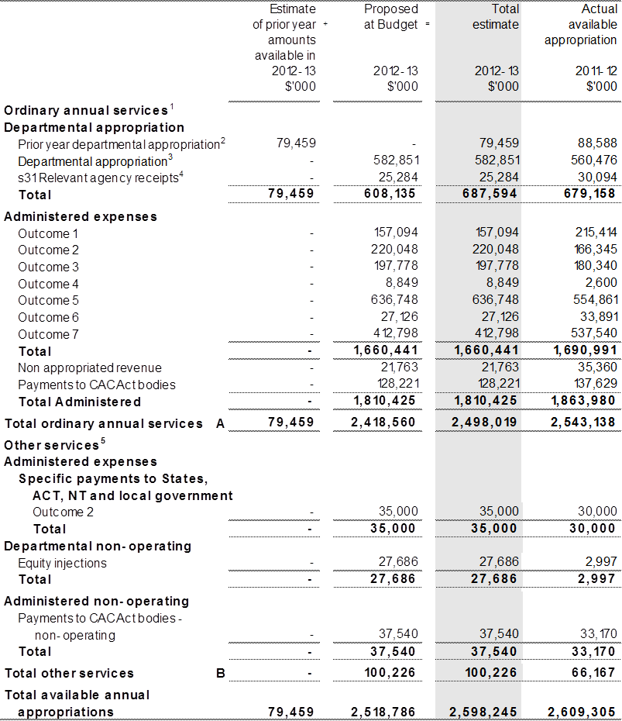
Portfolio Budget Statements

Slide 46
Portfolio Budget Statements

Slide 47
Questions?

