Slide 1
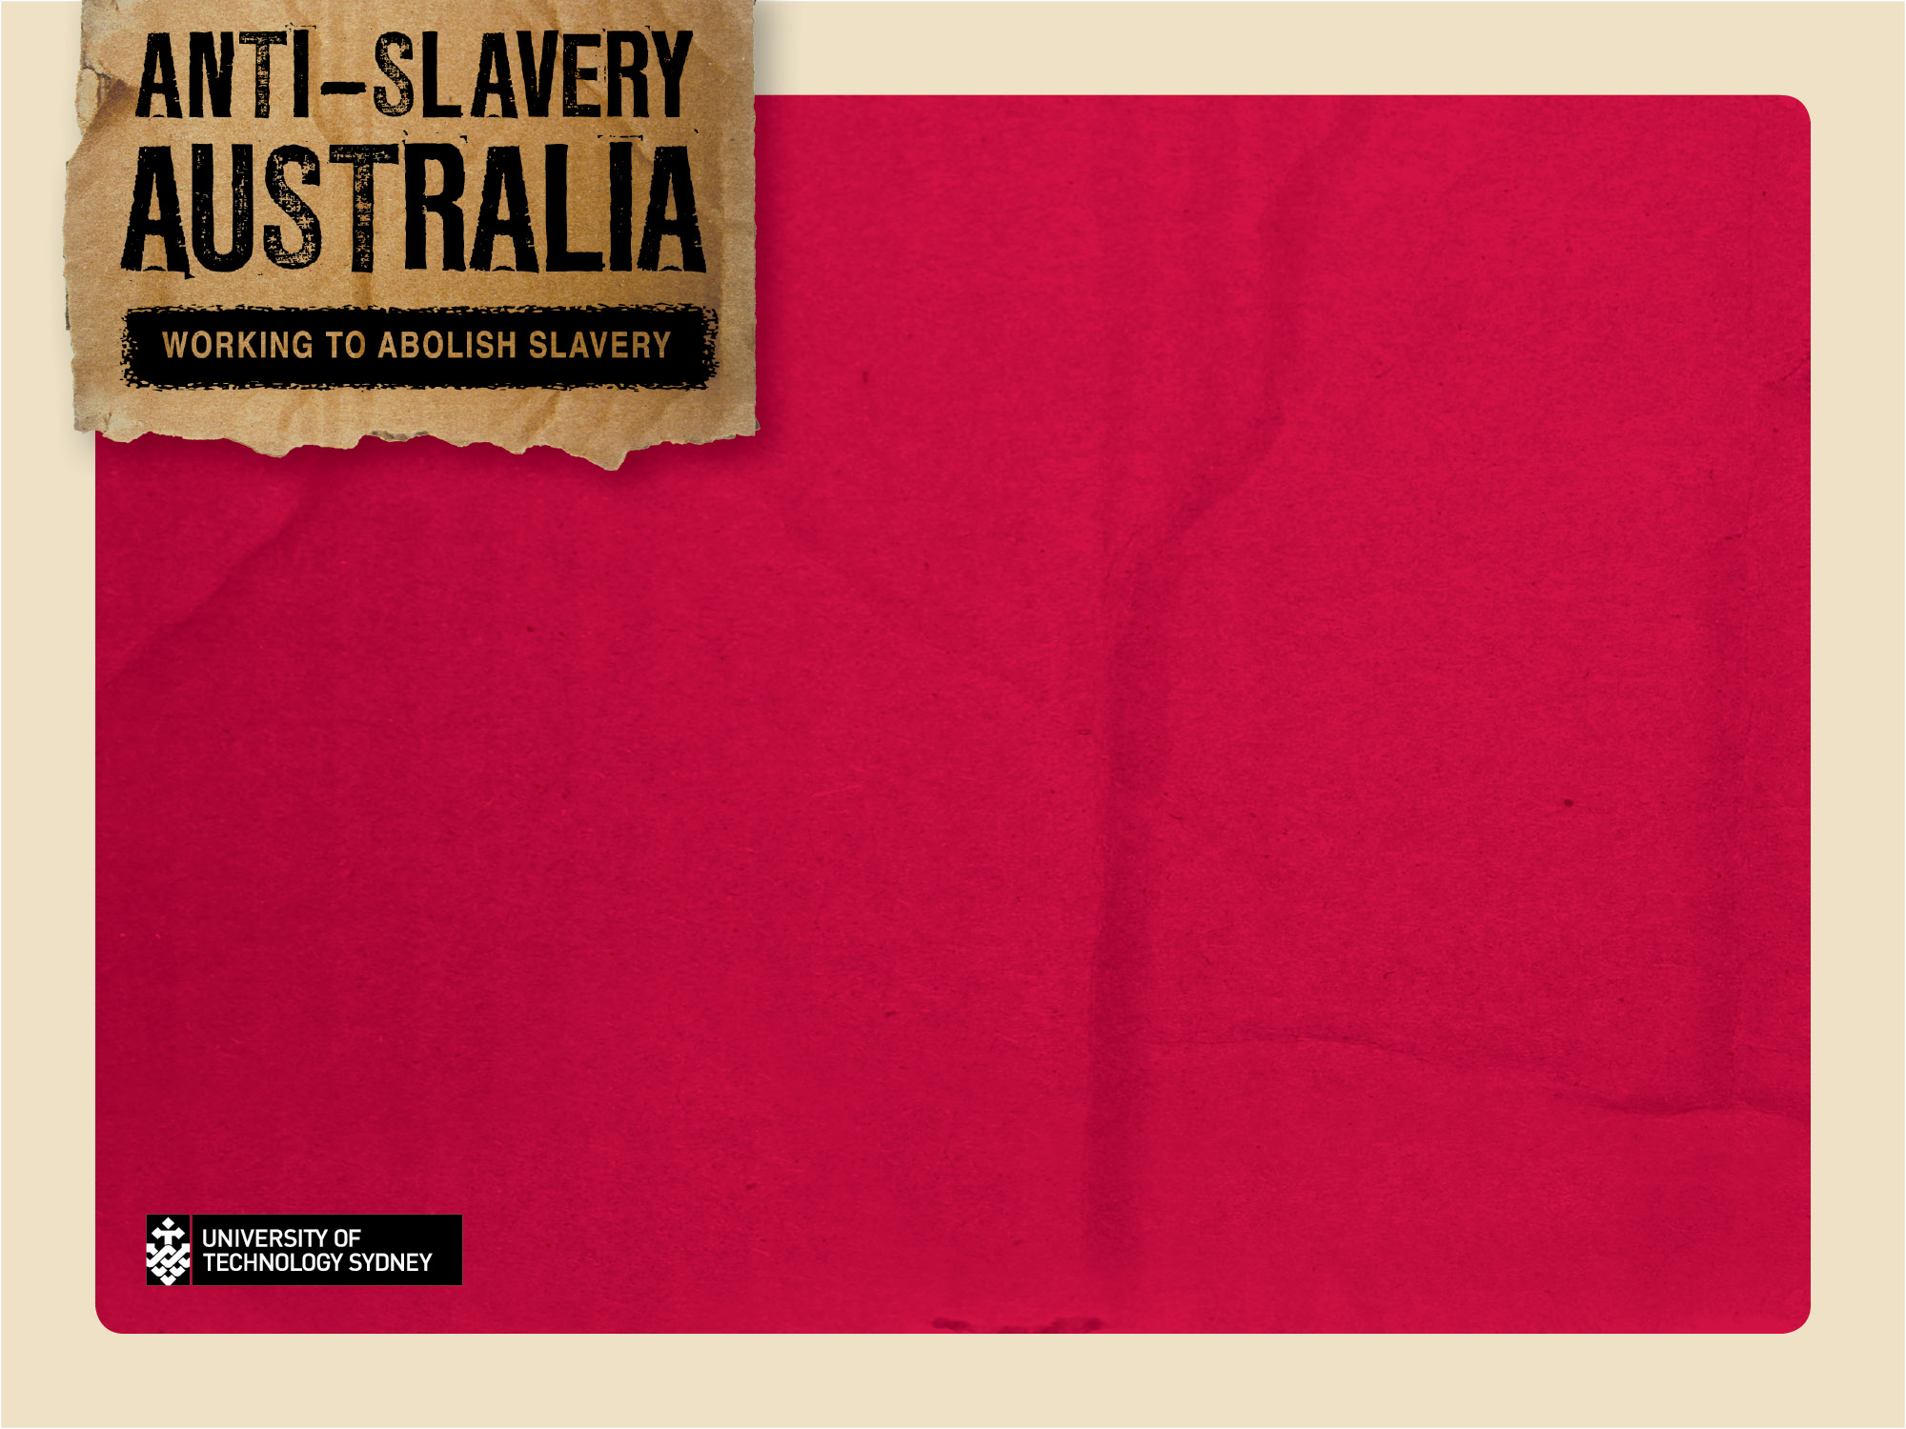
Trafficking and Slavery in Australia:
review, experiences & challenges
Parliamentary Library, Vital Issues Lecture
Jennifer Burn
Director, Anti-Slavery Australia

Slide 2
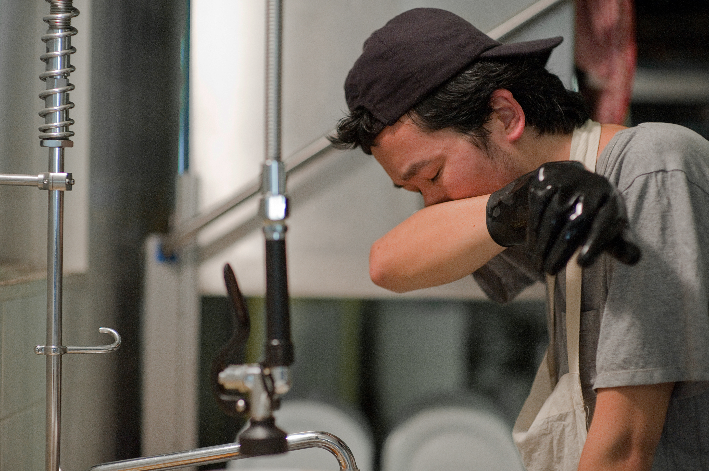
Trafficking and slavery in Australia

Slide 3
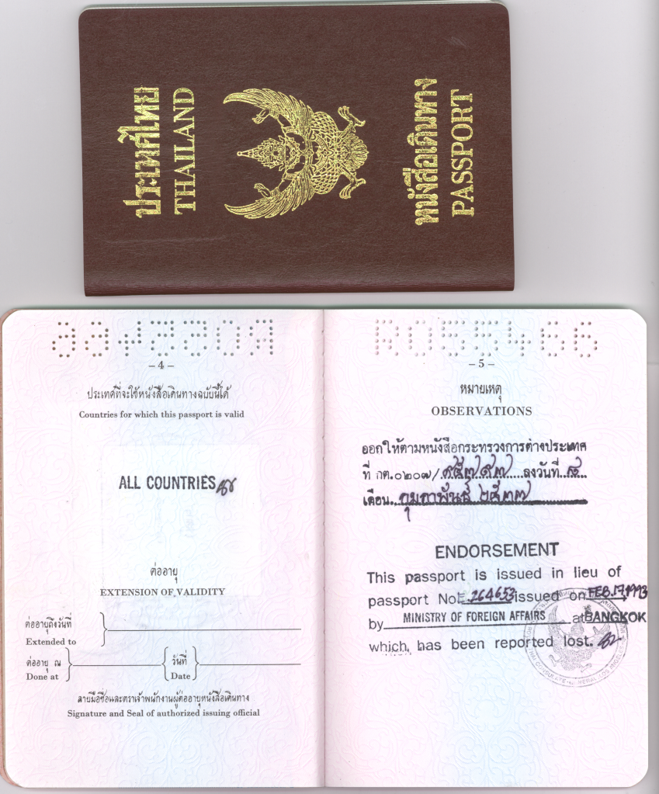
Trafficking & Slavery:
Shackles and chains have been replaced by:
Condition of ownership evidenced in other ways
Control of freedom of movement
Withdrawal of discretion over life decisions
Taking of identity documents and important documents
Sexual assault and other forms of violence
Deception about nature and conditions of work
Debt-bondage
Threats of deportation
Withholding of documents
Little or no payment for work
Threats to family members in home country
Isolation
Verbal abuse, humiliation
Psychological coercion is often coupled with threatened or
  actual physical violence and sexual assault
Social /linguistic isolation
Creation of fear of exposure, distrust of law enforcement,
  authority
Notes:
Human Trafficking is commonly referred to as modern-day slavery..
The face of modern-day slavery is a different one than the old form of chattel slavery, characterized by physical chains and forced removal that dominated the transatlantic slave trade .
Rather it is a prison with no walls, in which the tactics used are more underhanded and involve psychological coercion in the form of
We now see threats of deportation, often victims do not know they are in the country illegally so they are told that after and that in the process the authorities will hold them in jail, and abuse them.
Often, victims have their passports and papers confiscated as a control mechanism
Traffickers often control victim’s communication with family members, not allowing phone calls or mail to be received
Verbal abuse is often used as a way to deplete their self-esteem
Physical violence and sexual assault are also common elements in these types of situations.

Slide 4









Asian Women at Work

Slide 5
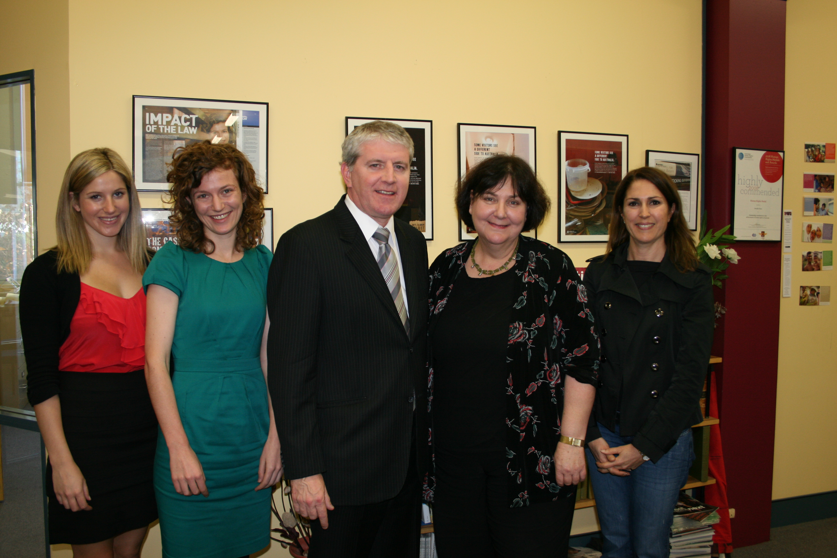
Anti-Slavery Australia +1

Slide 6
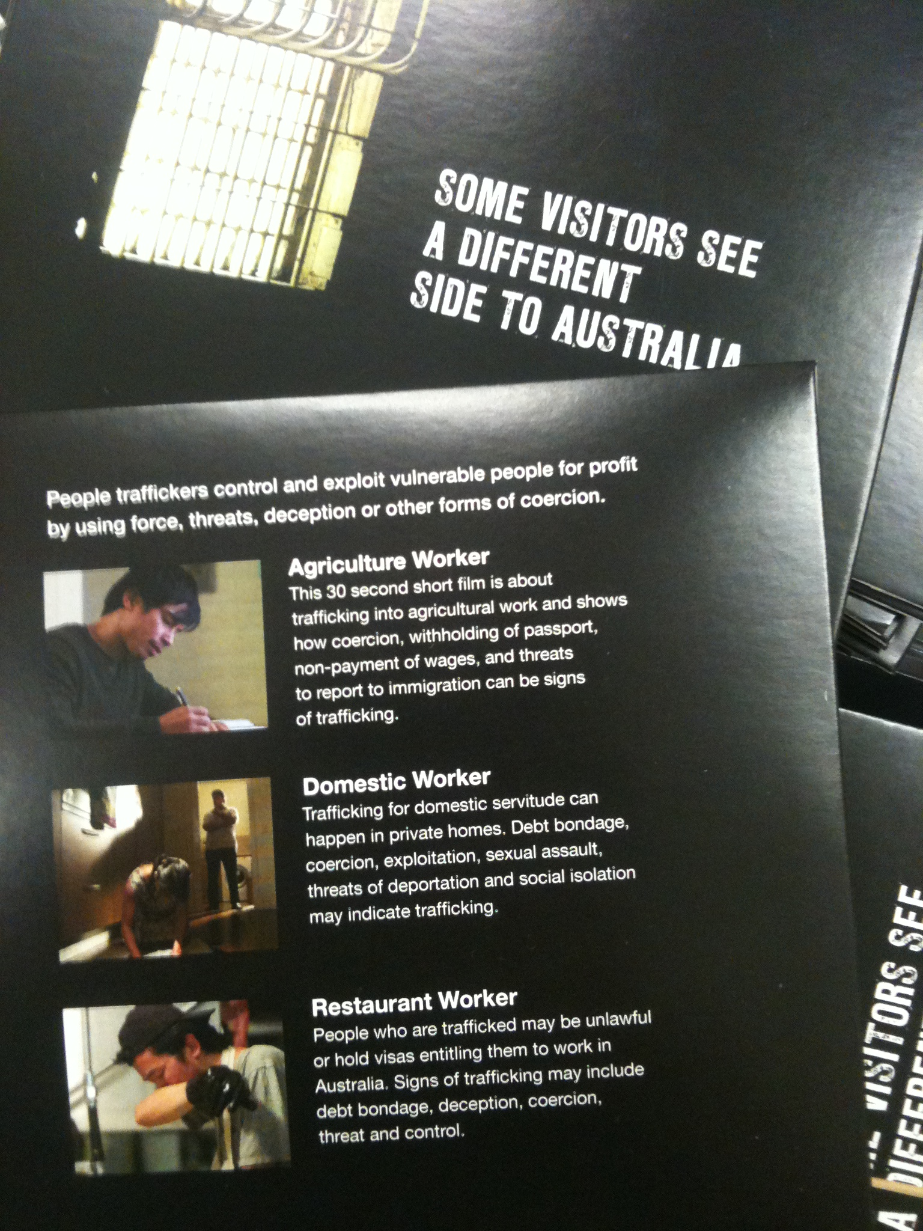
Bahasa Malaysian
Chinese
Hindi
Korean
Tagalog
Thai
Vietnamese

Slide 7
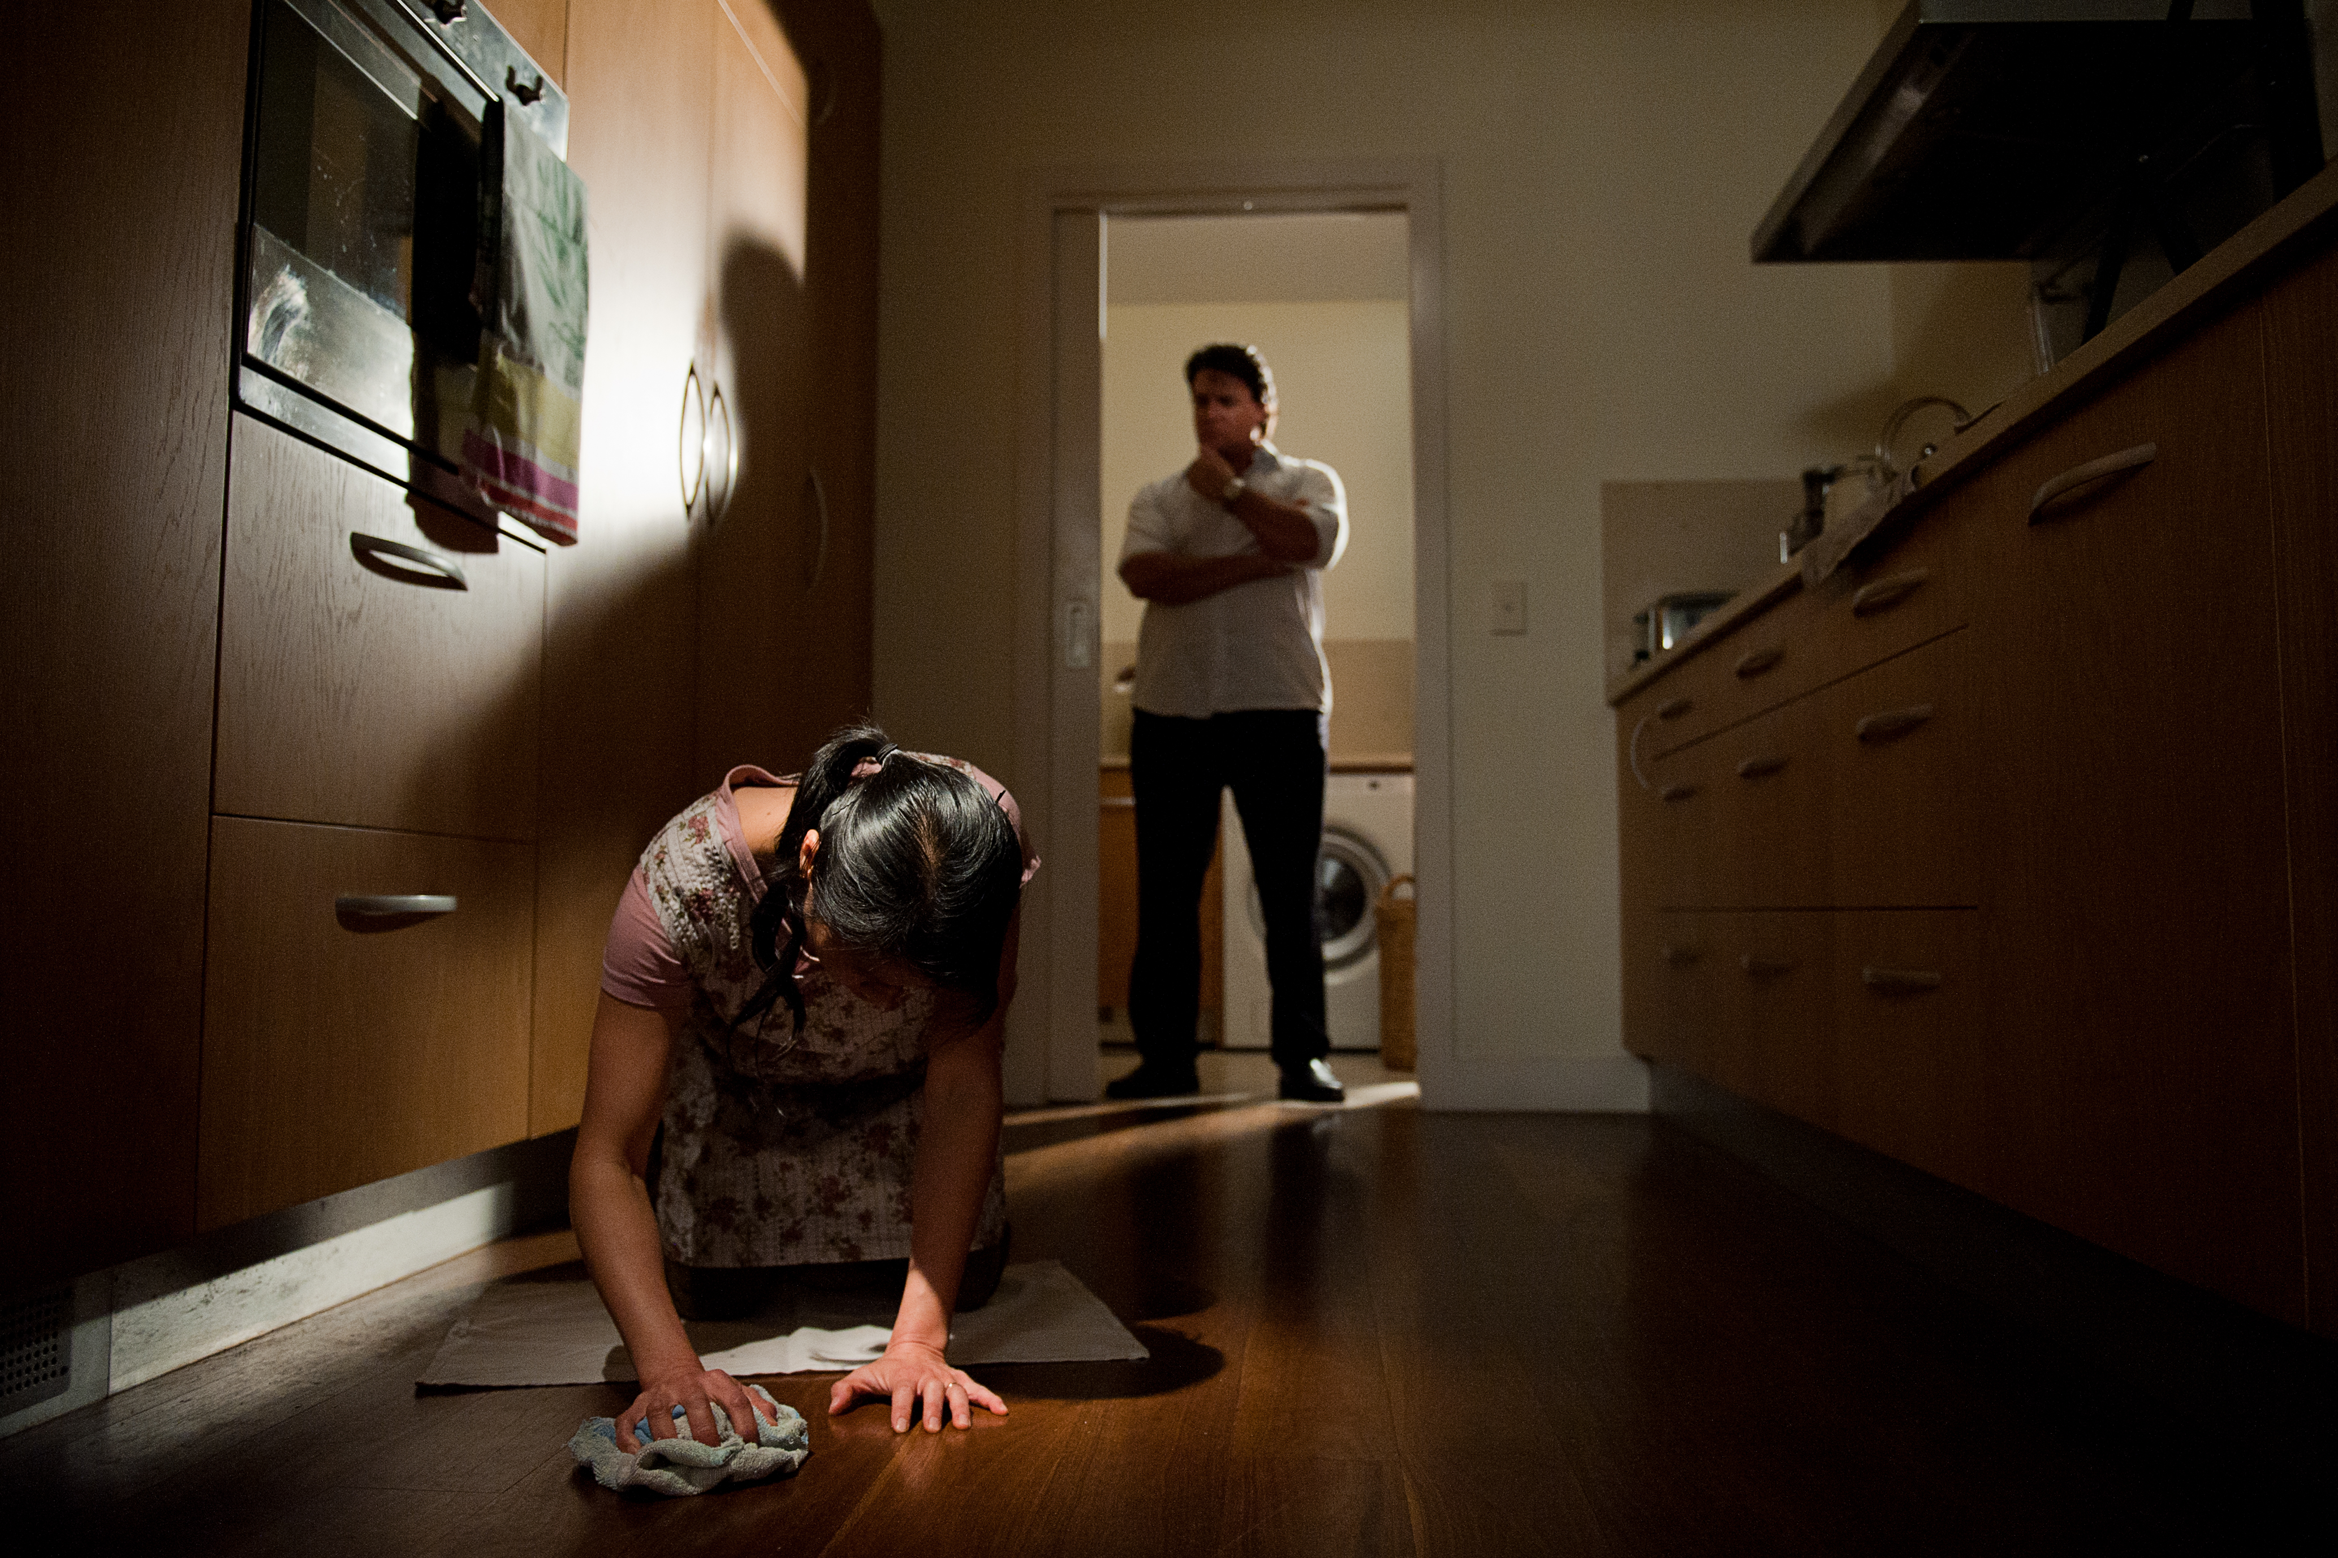
Slavery Convention, ratified 1927
Supplementary Convention on the Abolition of Slavery, the Slave Trade, and Institutions and Practices Similar to Slavery, ratified 1958.
United Nations Convention against Transnational Organized Crime, ratified 2005
Protocol to Prevent to Suppress and Punish Trafficking in Persons Especially Women and Children ratified 14 September 2005
    .
Criminal Code Act 1995 (Cth);
Criminal Code Amendment (Trafficking in Persons Offences) Act 2005
Division 270 -- Slavery, sexual servitude and deceptive recruiting
Division 271 -- Trafficking in persons and debt bondage

Slide 8
UN TRAFFICKING PROTOCOL
Criminalise trafficking in persons (articles 3 & 5)
Take measures to protect and assist the victims of trafficking, including considering the implementation of measures to help rehabilitate victims through the provision of housing and counseling and training (article 6)
Consider taking legislative or other measures to permit victims to remain in their territory, temporarily or permanently in appropriate cases (article 7)
Establish comprehensive policies, programs and other measures to prevent trafficking and protect its victims, especially women and children (article 9)
Australia ratified the Protocol in September 2005.

Slide 9
Protocol to Prevent, Suppress and Punish Trafficking in Persons Especially Women and Children
Article 3
“Trafficking in persons” shall mean the recruitment, transportation, transfer, harbouring or receipt of persons, by means of the threat or use of force or other forms of coercion, of abduction, of fraud, of deception, of the abuse of power or of a position of vulnerability or of the giving or receiving of payments or benefits to achieve the consent of a person having control over another person, for the purpose of exploitation. Exploitation shall include, at a minimum, the exploitation of the prostitution of others or other forms of sexual exploitation, forced labour or services, slavery or practices similar to slavery, servitude or the removal of organs;
The consent of a victim of trafficking in persons to the intended exploitation set forth in subparagraph (a) of this article shall be irrelevant where any of the means set forth in subparagraph (a) have been used;
The recruitment, transportation, transfer, harbouring or receipt of a child for the purpose of exploitation shall be considered “trafficking in persons” even if this does not involve any of the means set forth in subparagraph (a) of this article;
“Child” shall mean any person under eighteen years of age.

Slide 10
THE THREE ELEMENTS OF TRAFFICKING
1
2
PROCESS
MEANS
3
Recruiting
OR
Harboring
OR
Moving
OR
Obtaining
a person,
by
Force
OR
Fraud
OR
Coercion
END
For the purposes of
Involuntary Servitude
OR
Debt Bondage
OR
Slavery

Slide 11
Table 1: Criminal Code - Divisions 270 and 271
Section | Offence | Maximum Penalty
270.3(1) | Possess or exercise right of control over a slave | 25 years
270.3(2) | Commercial transactions involving a slave | 17 years
270.6(1) | Causing another person to enter into or remain insexual servitude (see s270.4 (1) for definition of sexual servitude) | 15 years/20 years (aggravated offence*)
270.6(2) | Conducting a business involving the sexual servitude of another (see s270.6(3) for definition of conducting a business) | 15 years/20 years (aggravated offence*)
270.7(1) | Intentionally inducing another person to enter into an engagement where the other person is deceived about providing sexual services, the nature of the sexual services to be provided, extent to which the person will be free to leave or cease providing sexual services, involvement of exploitation or debt bondage or confiscation of travel or identity documents (see s270.6(2) for definition of sexual service and s271.1 for definition of deceive) | 7 years/9 years (aggravated offence*)
271.2(1), (1A), (1B), (1C) | Trafficking offences involving the use of force or threats, or recklessness as to whether the trafficked person will be exploited (see s271.5 for domestic trafficking offences) | 12 years/20 years (aggravated offence#)
271.2(2), (2A) | Trafficking offences where there is an arrangement for the trafficked person to provide sexual services but is deceived about the nature of those sexual services, freedom to leave or cease providing sexual services, or any debt owed in connection with the arrangement | 12 years/20 years (aggravated offence#)
271.4(1), (2) | Trafficking in children offences where there is intention for or reckless as to whether the child will be used to provide sexual services or be otherwise exploited (see s271.7 for domestic trafficking in children offences) | 25 years
271.8(1) | Intentionally causing another person to enter into debt bondage | 12 months/2 years (aggravated offence*)

Slide 12
Slavery
OFFENCES – Criminal Code 1995
A person who intentionally :
Possesses a slave or exercises the right of ownership over a slave;
Engages in slave trading
Enters into any commercial transaction involving a slave
Exercises control or direction or provides finances for slave trading or commercial transactions
  25 years imprisonment
  (If a person is reckless as to whether a transaction involves a slave and enters into a commercial transaction, directs, finances or exercises control over slave trading : 17 years imprisonment ).

Slide 13
Provisions – 1999
270.1 Definition of slavery
  For the purposes of this Division, slavery is the condition of a person over whom any or all of the powers attaching to the right of ownership are exercised, including where such a condition results from a debt or contract made by the person.

Slide 14
R v Wei Tang [2006] VCC 637 at [6]:
How could they run away when they had no money, they had no passport or ticket, they entered on an illegally obtained visa, albeit legal on its face, they had limited English language, they had no friends, they were told to avoid immigration, they had come to Australia consensually to earn income and were aware of the need to work particularly hard in order to pay off a debt of approximately $45 000 before they were able to earn income for themselves?

Slide 15
The Queen v Tang, Gleeson CJ
[it is] important not to debase the currency of language, or to banalise crimes against humanity, by giving slavery a meaning that extends beyond the 1926 Convention” and that harsh or exploitative conditions of labour do not of themselves amount to slavery.
The question of when a person has been enslaved is a complex one that involves questions of fact and degree. The ability to deal with a person ‘as a commodity’ or ‘an object of sale and purchase, may be a powerful indication that a case falls on one side of the line [between harsh employment and slavery’

Slide 16
Exercise of power over the victims
Power to make each woman an object of purchase;
Power to control and restrict their movements;
Power to use their services without commensurate compensation

Slide 17

Forced Labour Convention 1930 (ILO No. 29)
Adopted 1930 , Australia ratified 1933.
Article 2(1):
  For the purposes of this Convention the term "forced or compulsory labour" shall mean all work or service which is exacted from any person under the menace of any penalty and for which the said person has not offered himself voluntarily.
Article 25:
  The illegal exaction of forced or compulsory labour shall be punishable as a penal offence, and it shall be an obligation on any Member ratifying this Convention to ensure that the penalties imposed by law are really adequate and are strictly enforced.
Abolition of Forced Labour Convention 1957 (ILO No. 105)
Adopted 25 June 1957.
Entered into force 17 January 1959.

Slide 18
Criminal Code Act 1995 (Cth), Schedule 1
Dictionary
"exploitation , of one person (the victim ) by another person (the exploiter" ), occurs if:
  (a) the exploiter's conduct causes the victim to enter into slavery, forced labour or sexual servitude; or
  (b) the exploiter's conduct causes an organ of the victim to be removed and:
    (i) the removal is contrary to the law of the State or Territory where it is carried out; or
    (ii) neither the victim nor the victim's legal guardian consented to the removal and it does not meet a medical or therapeutic need of the victim.
Section 73.2(3)
"forced labour" means the condition of a person who provides labour or services (other than sexual services) and who, because of the use of force or threats:
  (a) is not free to cease providing labour or services; or
  (b) is not free to leave the place or area where the person provides labour or services.

Slide 19
Case Studies
1. International Student
Finds cost of living higher than expected. Working over 20 hours/week
Underpaid
Threatened / beaten
2. Australian citizen
Working in textile industry
Paid $3/hour
3. Working holiday cleaner
Working 7 days/week, 14 hours/day
Debt of $30 000
Family threatened
4. Partner visa
Working 7 days/week
Threatened with deportation
Repeatedly assaulted

Slide 20
 | Trafficking - organising or facilitating travel | Harsh or exploitative working conditions | Forced Labour | Slavery
Powers attaching to the right of ownership
Deception about employment conditions
Force or threats
Restriction of movement and confinement
Debt bondage
Threats to report to immigration or police
Retention of passport and identity documents
Object of sale and purchase
Threats of dismissal
Very poor wages

Slide 21

Migration Amendment (Employer Sanctions) Act 2007 (Cth)
Howell Report
Worker Protection Act 2008 (Cth)
Fair Work Act 2009 (Cth)

Slide 22
National Taskforce
The Anti People Trafficking Interdepartmental Committee (IDC):
The Attorney-General’s Department
The Australian Building and Construction Commission
The Australian Crime Commission
The Australian Federal Police
The Australian Institute of Criminology
The Australian Agency for International Development (AusAID)
The Commonwealth Director of Public Prosecutions
The Department of Education, Employment and Workplace Relations
The Department of Foreign Affairs and Trade
The Department of Immigration and Citizenship
The Fair Work Ombudsman
The Australian Government Office for Women in the Department of Families, Housing, Community Services and Indigenous Affairs
The Department of the Prime Minister and Cabinet

Slide 23
Australian Government, Anti-People Trafficking Interdepartmental Committee, Trafficking in Persons: The Australian Government Response: 1 May 2009-30 June 2010 (2010)
Available through the Attorney-General’s website:
www.ag.gov.au

Slide 24
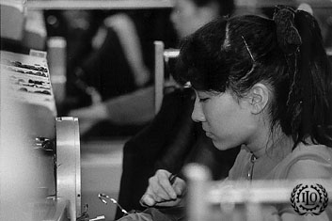
People Smuggling
The Protocol Against Smuggling of Migrants by Land Sea and Air defines people smuggling as: “the procurement in order to obtain, directly or indirectly a financial or other material benefit, of the illegal entry of a person into a state Party of which the person is not a national or permanent resident”.
Photo by J. Maillard, International Labour Organization

Slide 25
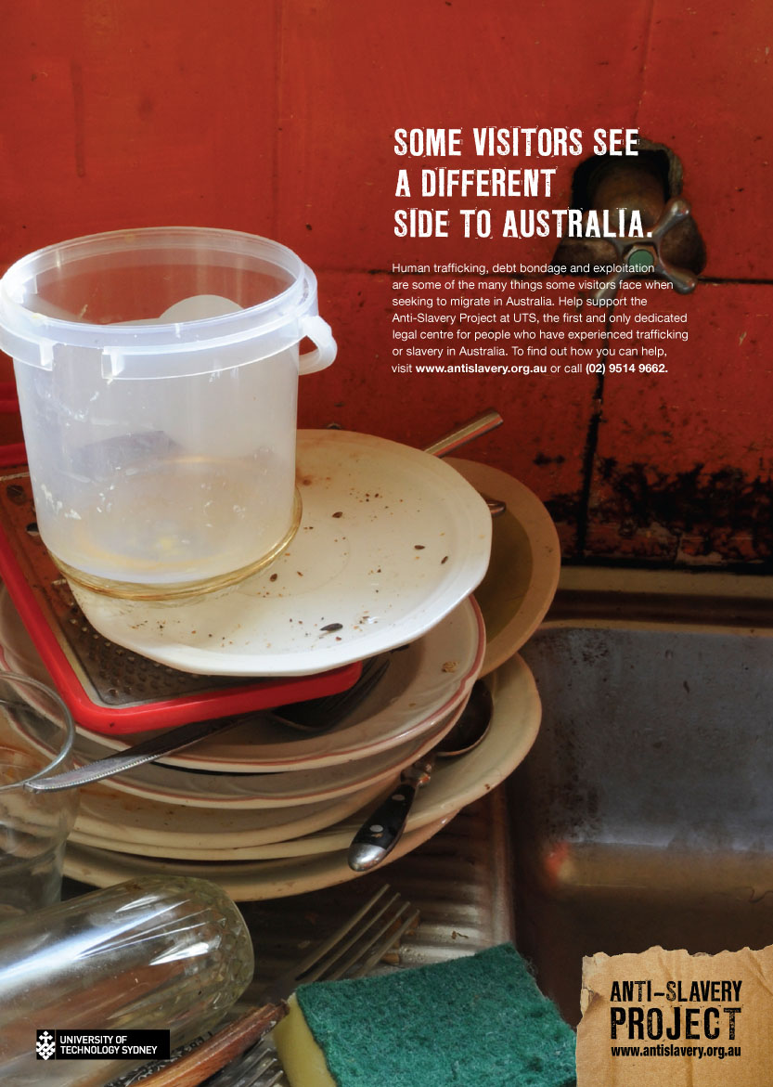
People Trafficking Visa Framework
Established by the Federal Government on 1 January 2004.
Amended from July 2009.
Consists of the Bridging F visa, the Criminal Justice Stay visa and the Witness Protection (Trafficking) Permanent visa.

Slide 26
Visa Reforms
Table 5: Total Support Program client numbers, by industry exploitation type and gender, January 2004 to 30 June 2010 *
 | Other forms of labour exploitation | Sexual exploitation | Total from 1 January 2004 to 30 June 2010
Male | 11 | 0 | 11
Female | 12 | 132 | 144
Total | 23 | 132 | 155
* Taken from Australian Government, Anti-People Trafficking Interdepartmental Committee, Trafficking in Persons: The Australian Government Response: 1 May 2009-30 June 2010 (2010) 13.

Slide 27
Visa Reforms
Table 7: Number of clients on the Support Program, by stream of support*
Stream | As at May 2009 | As at 30 June 2010 | Total number of clients between 1 January 2004 and 30 June 2010
Assessment | 2 | 1 | 52
Extended intensive support | 0 | 0 | 5
Justice Support | 40 | 50 | 97
Temporary Trial | 0 | 0 | 1
Total | 42 | 51 | 155
* Taken from Australian Government, Anti-People Trafficking Interdepartmental Committee, Trafficking in Persons: The Australian Government Response: 1 May 2009-30 June 2010 (2010) 13.

Slide 28
Clients on the Support Program
By Country of origin/citizenship as at 30 June 2010*
Country of origin/citizenship | Clients on support program
Fiji | 1
India | 2
Malaysia | 10
Philippines | 2
South Korea | 6
Thailand | 29
Viet Nam | 1
* Taken from Australian Government, Anti-People Trafficking Interdepartmental Committee, Trafficking in Persons: The Australian Government Response: 1 May 2009-30 June 2010 (2010) 14.

Slide 29
National Roundtable on People Trafficking
Anti Slavery Australia
Australian Catholic Religious Against Trafficking in Humans
Scarlet Alliance, Australian Sex Workers Association
Project Respect
Salvation Army
Victim Support Australasia
NSW Rape Crisis Centre
Josephite Counter Trafficking Project
Australian Government Attorney General’s Department
Australian Government Department of Immigration and Citizenship
Australian Government Office for Women
Fair Work Ombudsman, and
Australian Human Rights Commission.

Slide 30
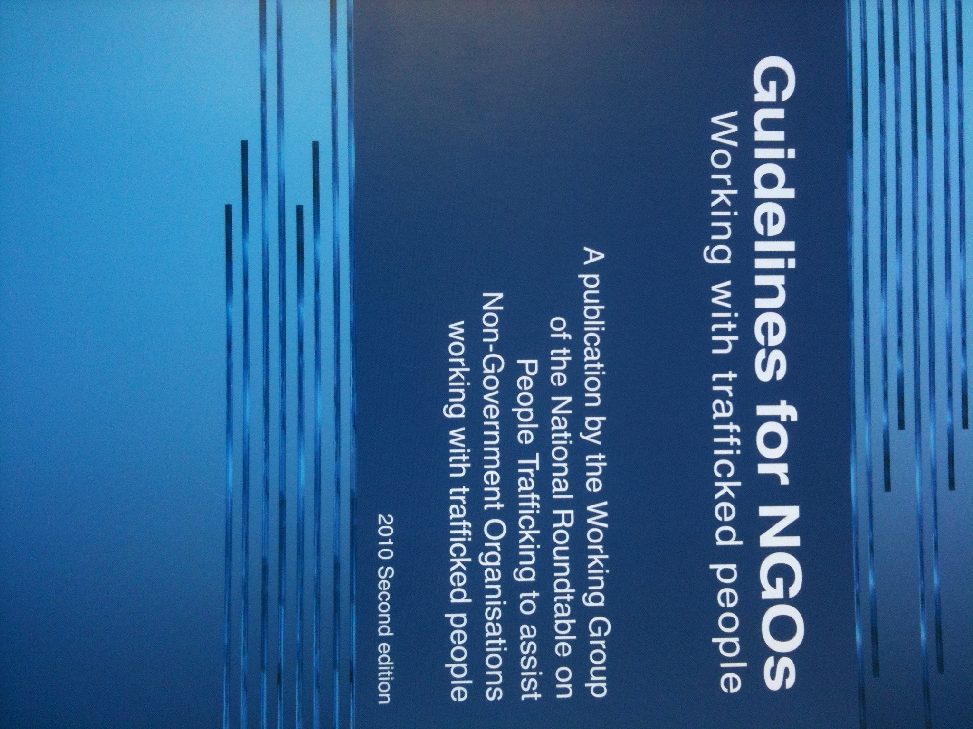
Guidelines for NGOs working with Trafficked People
10 principles for working safely and ethically with trafficked people
Understand and protect the rights of trafficked people.
Always act to protect people’s safety.
Negotiate informed consent.
Provide appropriate referrals.
Protect privacy and confidentiality.
Provide culturally appropriate services.
Provide professional and ethical services.
Know how to respond to subpoenas and other requests for information.
Know how to support witnesses in court proceedings.
Recognise that families and children have special needs.

Slide 31
Support for trafficked people program
The Office for Women administers the support program for trafficked people. The Australian Red Cross is contracted to provide support.
Includes accommodation, casework support, assistance obtaining legal advice, medical support and counselling.
Emerging & increasingly difficult challenges: housing, access to English language tuition, vocational training, increased need for counselling support, continuing or reemerging trauma.

Slide 32
Forced marriage
No legal definition- marriage entered into without the full and free consent of one or both parties, where the marriage occurs as a result of duress or fraud often involving physical or psychological coercion.
What do we know about forced marriage in Australia?
Protective (civil protection orders) or punitive(criminal sanctions).
Men and women in forced marriages may experience psychological and physical injuries, sexual assault, domestic violence, false imprisonment and social isolation.

Slide 33
Forced marriage
Australian legislative responses
  Family Law Act 1975 provides for orders to prevent marriages of children but not for vulnerable adults
Forced marriage may overlap with slavery, trafficking in persons or forced labour
  Conduct causing a person to enter into forced marriage
  Facilitating or bearing witness to a marriage in the knowledge of lack of consent of one of the parties
  Conduct of intentionally or recklessly causing a person to be maintained in a condition of forced marriage

Slide 34
Forced marriage
Forced marriage community advisory council;
Research
gender based violence – VAW
Guidelines & awareness raising materials
Safety and well being of those at risk of or who have experienced forced marriage
Family violence provisions

Slide 35
Reintegration – country of origin
Lack of awareness about reintegration programs
Experiences from clients – fear of stigma and shame – characterised as ‘trafficked’ ‘sex slave’.

Slide 36
Victim support
Housing
Access to English language training
Vocational training
Barriers to family reunion
Barriers to visa grant

Slide 38
The right to effective remedies
Statutory victims compensation schemes are different in every state and territory.
Reform
  National Compensation Scheme OR
  Strengthen State & Territory schemes
Anti-Slavery Seminar on effective remedies
  18 November 2011 antislavery@uts.edu.au

Slide 39
Priorities
Sydney anti-trafficking network
Forced marriage
Compensation
Victim support : housing, vocational training, access to English language training
Supply chain
Criminal law framework : Deceptive recruitment

Slide 40
Contact Anti-Slavery Australia
www.antislavery.org.au
antislavery@uts.edu.au
jennifer.burn@uts.edu.au
(02) 9514 9662

