Slide 1

Prices These Days!
The Cost of Living In Australia
AMP-NATSEM Report 31
Ben Phillips June 20, 2012
Notes:
Thank you
Acknowledging Jinjing and Matt Taylor and the team at AMP for invaluable contributions.

Slide 2
Introduction
Report analyses cost of living pressures in Australia
  Are households better/worse off than previous decades?
  Which groups in Australia are at most pressure?
  Is it prices or expectations/wants that drive the pressures?
  What are we spending our money on these days?
  Which capital cities are most expensive?
  International comparisons

Slide 3
The Macro picture on prices and income in Australia

Slide 4
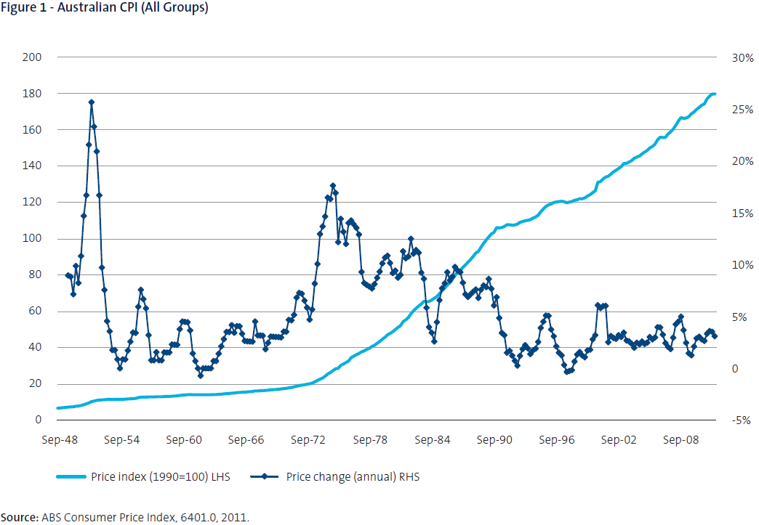
The macro picture on prices in Australia
Notes:
Over 20 years of low inflation (CPI) roughly between 0 and 5% pa. CPI averaged 2.6% pa while wages grew by approx 4.5% pa. GDP per capita is 45% higher than 1991.
How is it possible to have a cost of living ‘crisis’ with this prosperous economy? Perhaps not everyone has enjoyed the ride? Low income hh’s? Pensioners? Non-mining states? Or is something else? CPI not a good measure of cost of living? We consider these issues.

Slide 5
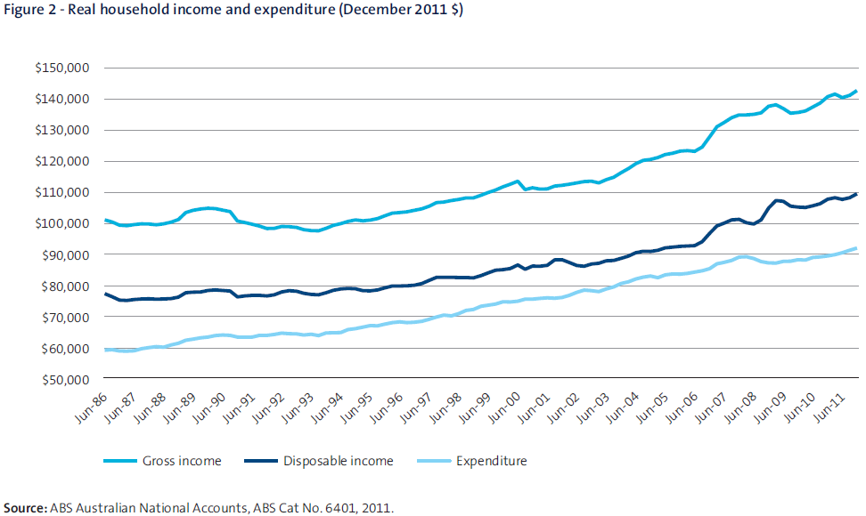
National Accounts – Real Income/Expenditure (per-household)

Slide 6
ABS Surveys – Real Disposable income

Slide 7
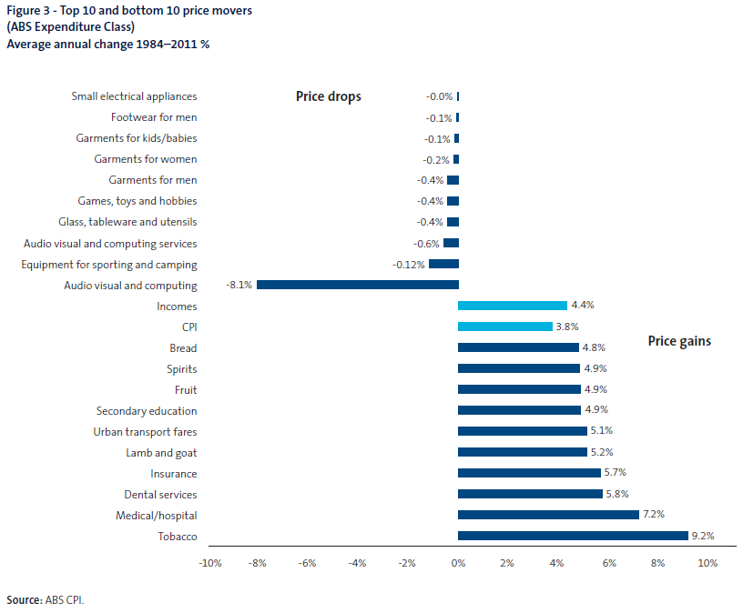
What’s gone up? What’s gone down in price?
Notes:
Much focus for COL pressures is electricity, petrol, fresh fruit and vegetables, water, gas. In terms of high inflation items these aren’t the big movers. We also forget that many items shrink in price eg. AV and computing, clothing, appliances. Many of these items the ticketed price is actually LESS than in 1984! Electricity averaged 4.7% pa, water 4.5% so roughly in line with incomes (recent growth is much higher at around 10 % pa).

Slide 8
Luxuries versus Necessities
Discretionary items
Necessities
Relative necessity
Have necessities increased more in price than other items? Do we devote more expenditure to necessities?

Slide 9
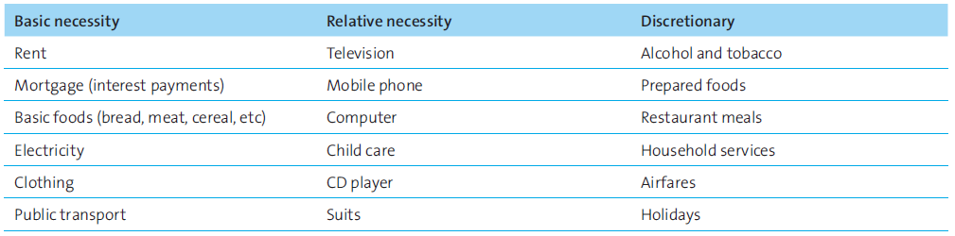
Examples

Slide 10
Discretionary and Necessary Spending
Notes:
Necessities – shelter, energy, food, clothing; Relative necessities – economic essentials – mobile phones, computers, childcare, Discretionary – luxuries, alcohol, tobacco, restaurant meals.
Not surprisingly higher income groups spend more on discretionary while low income households devote most to necessities. Surprisingly about 1 in 3 of low income $s go to discretionary
No evidence that the share spent on essentials (the main story behind cost of living pressures) is increasing in fact we spend more on discretionary items than in the past – even true for low income earners.

Slide 16
Living Cost Indexes
CPI vs LCI vs cost of living index
How is an LCI calculated
Data sources
Standard of living

Slide 17
Living Cost Index
Notes:
Employee = 3.1% pa
Pensions = 3.1% pa
Self-funded = 2.9% pa
CPI = 2.9 %
What about more detailed analysis?

Slide 18
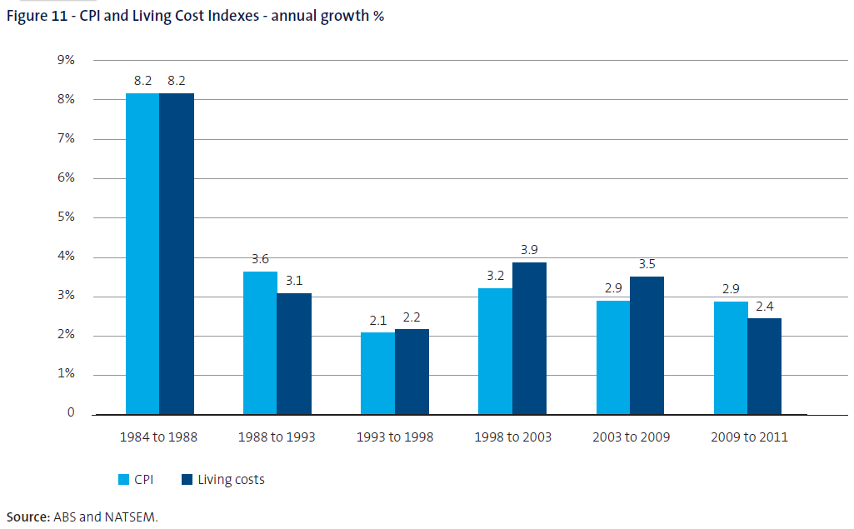
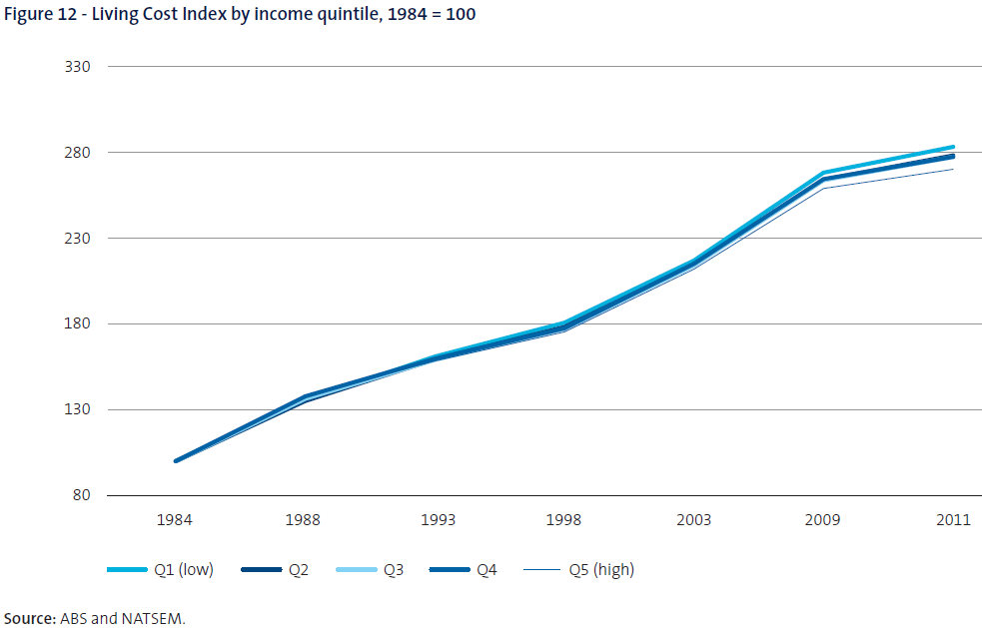
Living Costs Index
Notes:
Living costs (similar to the ABS CPI but includes mortgage interest costs – an often cited concern with the CPI)
Living costs are similar through time with the exception of the 80s where we had high interest rates
Prices are a story of in control rather than out of control.
Living costs have very little difference between high and low income households in spite of increased electricity/petrol/housing costs

Slide 19
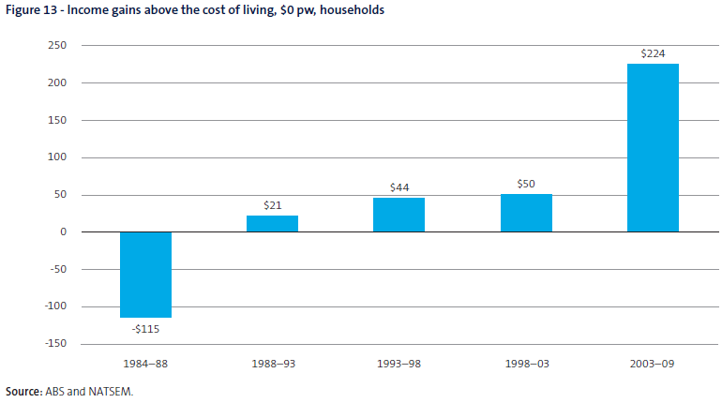
Standard of living gains
Notes:
Household disposable incomes grew by $224 pw on average beyond living costs. Following a difficult late 1980s there has been continual gains and the greatest gains occurred in the most recent decade.
The highest income earners are ahead by $429 pw while low income earners gained $93 pw beyond their respective costs of living. Interestingly, the strongest gains occurred in unison with greater cries around cost of living pressures – why?

Slide 20
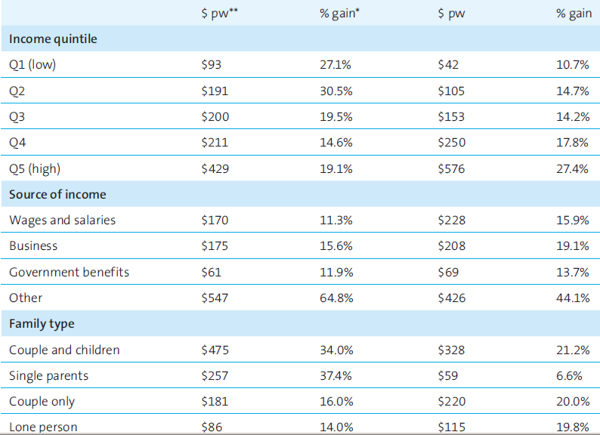
Income gains beyond the cost of living

Slide 21
What are we spending all the extra money on?

Slide 22
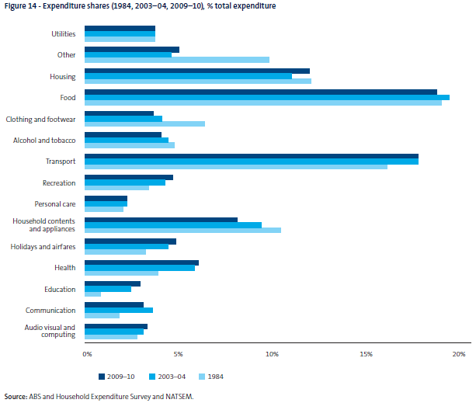
Notes:
Spend MORE on services, discretionary and aspirational items – recreation, education (secondary – private, and tertiary – HECS), childcare, holidays and airfares
Spend LESS on tobacco, clothing and footwear, hhld contents and appliances (government impacts here from taxation and lower prices through lower tariffs and strong $A)
Spend SAME on utilities, food and housing
Story here is that we spend more on outsourcing our time to services (childcare, eating out), aspirations (education), larger lifestyles (holidays, recreation), NOT that we devote enormous $s to electricity, petrol etc….
Note that Utilities only make up 4% of expenditure which has not altered through time – yet elections are won and lost on this one!!

Slide 23
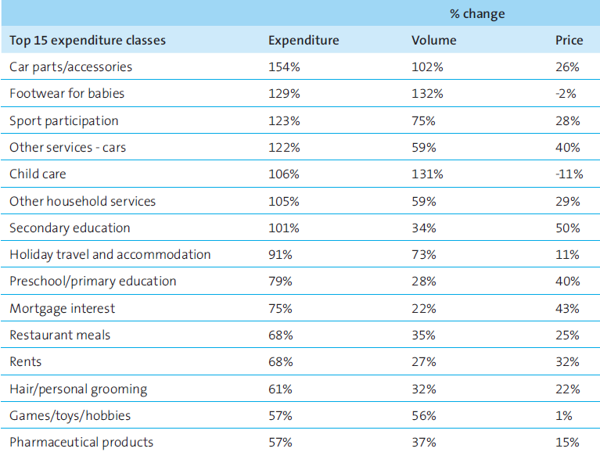
Expenditure, Volume and Price Change

Slide 24

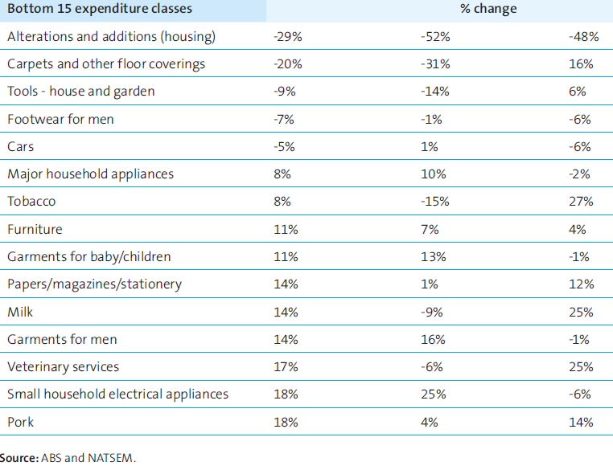

Slide 25
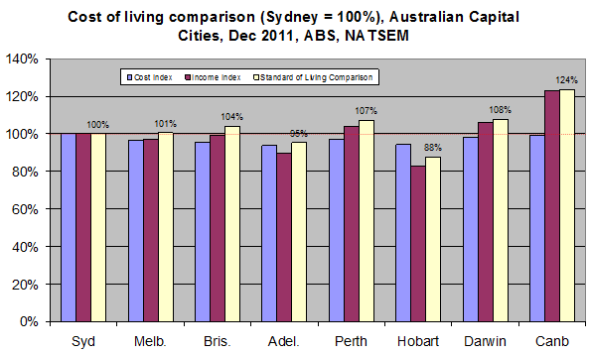
Capital City Cost of Living Comparison
Notes:
Sydney most expensive cap city
Adelaide least expensive
Cbr highest standard of living
Prices actually don’t differ a great deal between capital cities – mortgage costs and rents

Slide 26
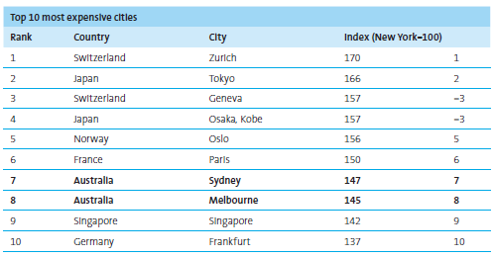
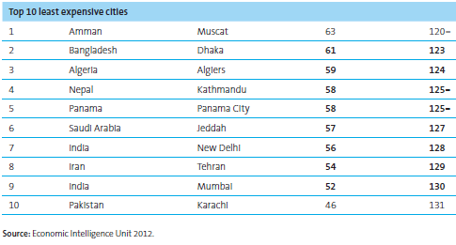
International Cost of Living Comparison
Notes:
These surveys suggest from an international job market perspective that Australian cities are very expensive. They say little about the costs for those earning money in the local currency.
One gets a sense these ‘expensive’ countries are also the countries one would want to live in!
The IMF and UN do show that Australia ranks #11 and #2 in terms of GDP per capita and living standards respectively.

Slide 27
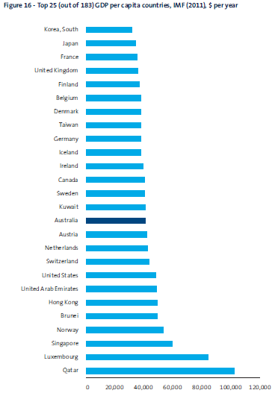
GDP per capita

Slide 28
Conclusions
Many households are doing it tough – but on average this situation is not getting worse in fact most are doing better.
Cost of living pressures have more to do with pressures of modern living and aspirations than Prices these days!
Given that prices are in control government policy is better focussed on staple areas (eg Health or education, the economy) rather than simplistic cost of living pressures.

Slide 29
THANKYOU FOR YOUR TIME TODAY
Ben Phillips
Principal Research Fellow
NATSEM – University of Canberra
June 2012

