Slide 1
Budget Seminar
UNDERSTANDING THE BUDGET
Scott Kompo-Harms
Garth Day
Richard Webb

Slide 2
PART ONE
SCOTT KOMPO-HARMS
THE MACROECONOMICS OF THE BUDGET
Where to find budget aggregates.
Fiscal policy and the Budget.
What data are available in Budget paper # 1?

Slide 3
BUDGET PAPER 1
Divided into a series of statements:
Most statements are produced each year.
Statement 4 usually differs from year to year and has been used in the past to discuss a topic of interest to the government.

Slide 4
BUDGET PAPER 1
2010-11 Budget could look completely different – in which case, the material presented here will not be of much assistance...let’s assume that won’t happen!

Slide 5
BUDGET PAPER 1 – 2009-10 Contents
STATEMENT 1: BUDGET OVERVIEW
STATEMENT 2: ECONOMIC OUTLOOK
STATEMENT 3: FISCAL STRATEGY AND OUTLOOK
STATEMENT 4: ASSESSING THE SUSTAINABILITY OF THE BUDGET
STATEMENT 5: REVENUE
STATEMENT 6: EXPENSES AND NET CAPITAL INVESTMENT
STATEMENT 7: ASSET AND LIABILITY MANAGEMENT
STATEMENT 8: STATEMENT OF RISKS
STATEMENT 9: BUDGET FINANCIAL STATEMENTS
STATEMENT 10: HISTORICAL AUSTRALIAN GOVERNMENT DATA

Slide 6
BUDGET PAPER 1 – Statement 1
Presents a brief summary of ‘headline’ Budget figures – cash and fiscal balances; key economic parameter forecasts – real GDP, employment growth, CPI, etc.
Place to go to obtain commonly cited figures contained in the Budget.

Slide 7
BUDGET PAPER 1 – Statement 2
Detailed forecasts and projections for key economic aggregates that underpin the Budget.
Assumptions made by Treasury in order to produce forecasts and projections.
Forecasts are made using information about behavioural relationships in the economy.
Projections are essentially made by assuming that variables return to their long-run average values.
Can be compared with actual data from ABS and other government agencies

Slide 8
BUDGET PAPER 1 – Statement 3
Contains information on Budget aggregates.
Cash and accrual accounting standards both used.
Two types of cash balance - Headline and Underlying.
Underlying cash balance adjusts for unusual items, such as proceeds of privatisations.
Accrual accounting results in the fiscal balance.
Difference between the two standards - timing of transactions.
Cash accounting records transactions as they take place, whereas accrual accounting records transactions as the are accrued. E.G. Public sector superannuation

Slide 9
BUDGET PAPER 1 – Statements 5 & 6
Present detailed data on revenue (statement #5), expenses and net capital investment (statement #6).
Reconciliation tables (also available for budget totals in statement #3) which show the source of any variations since the previous Budget – Policy changes vs Parameter and other variations
Policy changes - self-explanatory
Parameter and other variations – ‘Manna from heaven’ – unforeseen variations in revenue, expenditure or net capital investment

Slide 10
BUDGET PAPER 1 – Statement 7
Asset and liability management – changes to the General Government Sector (GGS) balance sheet.
Measures such as net debt, net worth and net financial worth – measures of ‘solvency’ of the public sector.

Slide 11
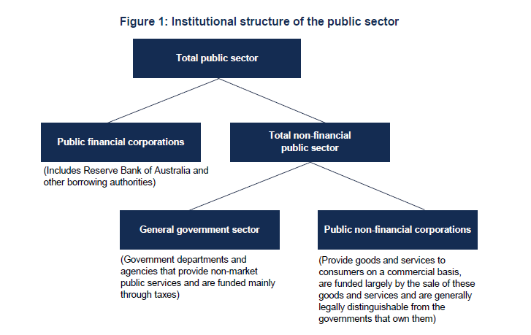
Brief Digression

Slide 12
BUDGET PAPER 1 – Statement 8
Contingent liabilities and assets – only become actual liabilities or assets on the GGS balance sheet if a certain event occurs. Said to be ‘contingent’ upon that event.
Separated into ‘quantifiable’ and ‘unquantifiable’.
Commonwealth’s financial claims scheme, other financial guarantees to the banks, states, etc. are shown here.
For the unquantifiable ones, it is nigh on impossible to estimate accurately just what the government would be ‘on the hook’ for.

Slide 13
BUDGET PAPER 1 – Statement 9
9 Budget Financial Statements – Cash flow statements, operating statements and balance sheets for the two main sectors of government (GGS and PNFCs) and their sum (NFPS).
These financial statements produced on a comparable basis to states and territories – Uniform Presentation Framework.
Used as inputs into ABS Government Finance Statistics (GFS) publication.
Can find forecasts and projections for net and gross debt in balance sheets.
Parliamentary Library Background Note is available on this topic.

Slide 14
BUDGET PAPER 1 – Statement 10
Contains historical Budget data.
Receipts, Expenses, Net Interest payments, etc.

Slide 15
Some additional comments
Overlap between fiscal and monetary policy.
‘Solvency’ of the public sector.
The Budget is a statement of the government’s expectations – not a statement of fact.

Slide 16
The Budget in context of the Fiscal Strategy
PART TWO
Garth Day

Slide 17
2009-10 Budget Papers

Slide 18
The structural and cyclical components of the budget
The primary budget balance comprises a structural and cyclical component:

Slide 19
What is structural and what is cyclical?
The structural component of the budget is driven by fiscal policy measures (decisions), termed discretionary fiscal policy.
The cyclical component of the budget is driven by fluctuations in economic activity impacting the cyclically-sensitive components of the budget:
  Individuals income tax
  Company tax
  Indirect tax
  Social security & welfare payments

Slide 20
The Government’s Fiscal Strategy
The 2008-09 budget formally introduced the Government’s fiscal strategy:
  Achieving budget surpluses, on average, over the economic cycle;
  Keeping taxation as a share of GDP, on average, below the level for 2007-08;
    expenditure < revenue, as % of GDP, on average
  Improving the Government’s net financial worth over the medium term.
    ‘structural’ or cyclically-adjusted budget surpluses

Slide 21
The 2nd Stage of the Fiscal Strategy
The 2009-10 Budget introduced the 2nd stage of the Government’s fiscal strategy:
  Holding real growth in spending to 2 per cent a year until the budget returns to surplus.
  The 2009-10 Budget holds real growth in spending below 2 per cent in the years the economy is projected to grow above trend.
    Over the forecast period GDP growth reverts to trend growth, so expenditure may exceed 2 per cent growth.

Slide 22
A comparison of fiscal strategies
The previous government’s fiscal strategy sought to maintain budget balance, on average, over the course of the economic cycle.
  This meant that an underlying ‘structural’ (cyclically-adjusted) budget balance of zero was the implicit medium-term target.

Slide 23
Why should we care about the Structural Budget Balance?
Traditionally, the Australian Government has not published estimates of the underlying ‘structural’ budget balance.
But the 2009-10 BP1 notes that:
  “It is worthwhile to access whether the budget is driven by cyclical or structural factors”
  The Government needs to know, implicitly or explicitly, whether the budget will be an underlying ‘structural’ surplus or deficit when framing each budget.

Slide 24
A short-run & medium-term target
The Government’s fiscal strategy and the GFC brings to the fore the concept of the structural budget position.
  Running a structural deficit in the short-run provided stimulus during the GFC.
  To meet the explicit medium-term target of budget surpluses, on average, requires structural surplus, on average.

Slide 25
Case Study: the GFC impact in 2008-09

Slide 26
The Long-run Structural Budget Balance

Slide 27
The Structural and Cyclical Components of the Budget

Slide 28
The cyclical component of the Budget:
Does history tells as anything about the future?

Slide 29
Summary
The Government’s fiscal strategy aims to achieve budget surpluses, on average, over the cycle and improve net financial wealth.
  What is the implicit target of these surpluses?
    Over the last 30 years, a structural surplus of around 1 per cent of GDP has been achieved by successive governments.
How will this Budget improve the structural budget position over the medium term?

Slide 30
PART THREE
Richard Webb
THE FINAL PART OF SEMINAR WILL COVER TWO ISSUES:
  HOW TO FIND YOUR WAY THROUGH THE BUDGET PAPERS
  UNDERSTANDING PORTFOLIO BUDGET STATEMENTS (PBS)
Notes:
WILL TALK ABOUT TWO THINGS
KEY BUDGET CONCEPTS
HOW TO FIND YOUR WAY THROUGH THE BUDGET PAPERS

Slide 31
SOURCES OF BUDGET INFORMATION
GOVERNMENT BUDGET WEBSITE: www.budget.gov.au/
PARLIAMENTARY LIBRARY
Budget Review 2010/11:
Opinion and analysis of the Budget in the media:
The Commonwealth Budget: process and presentation:
See small flyer on your chair for internet addresses for these services
Notes:
THE MAIN GOVERNMENT BUDGET WEBSITE IS WWW.BUDGET.GOV.AU
‘BUTTONS’ THAT WILL AUTOMATICALLY TAKE YOU TO THAT SITE CAN BE FOUND ON THE PARLIAMENTARY LIBRARY WEBSITE AT…
THE PARLIAMENTARY LIBRARY ALSO PROVIDES ANALYSIS IN THE BUDGET REVIEW AND MEDIA COVERAGE OF THE BUDGET WHICH CAN BE LOCATED BY…

Slide 32
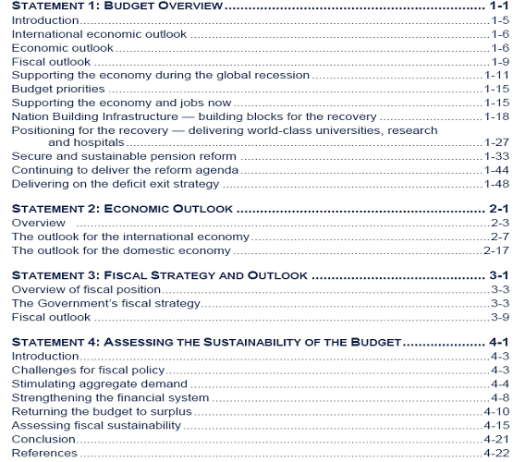
BUDGET PAPER NUMBER ONE – Statements 1 to 4
Notes:
BUDGET PAPER NUMBER 1 IS DIVIDED INTO 9 STATEMENTS.
THE ISSUES THAT SCOTT AND GARTH DISCUSSED ARE CONTAINED IN THE FIRST FOUR OF THESE STATEMENTS AS SHOWN IN THIS SLIDE:
BUDGET OVERVIEW
ECONOMIC OUTLOOK
FISCAL STRATEGY AND OUTLOOK, AND
ASSESSING THE SUSTAINABILITY OF THE BUDGET
THESE STATEMENT PROVIDE…[NEED SHORT SUMMARY]

Slide 33
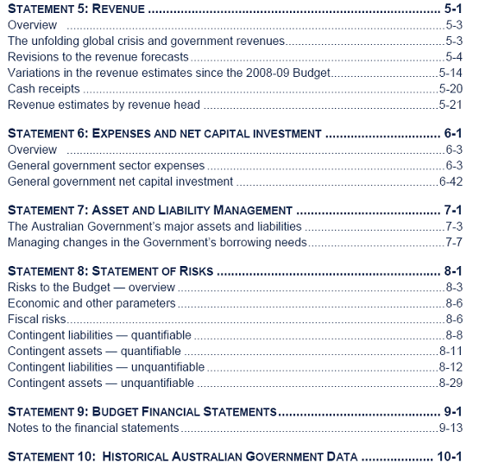
BUDGET PAPER NUMBER ONE – Statements 5 to 10
Notes:
I WILL DISCUSS THE STATEMENTS THAT YOU ARE MOST LIKELY TO USE AS THESE STATEMENTS CONTAIN DATA ON:
REVENUE – STATEMENT 5
EXPENSES – STATEMENT 6
FINANCIAL STATEMENTS – STATEMENT 9, AND
HISTORICAL DATA – STATEMENT 10

Slide 34
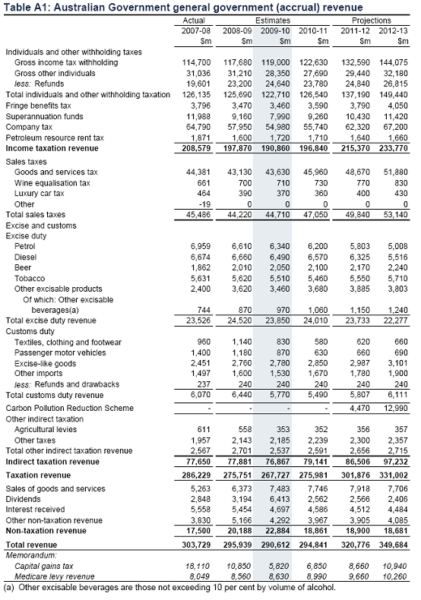
STATEMENT FIVE: Revenue

Slide 35
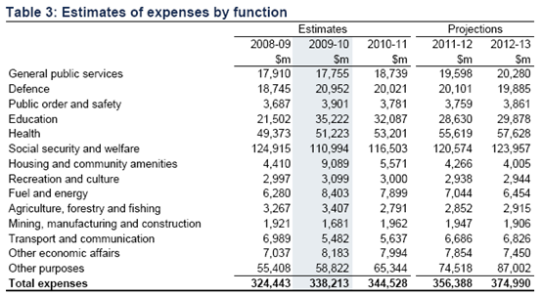
STATEMENT SIX: Expenses and Net Capital Investment
Notes:
Statement 6: expenses and net capital investment
Expenses is the term used to describe expenditure for current purposes
Capital expenditure is ‘net capital investment’. That is gross investment less depreciation
The Commonwealth spends relatively little by way of capital investment for its own purposes (in buying land, buildings, plant etc).
But the Commonwealth FUNDS much capital investment by way of PAYMENTS to the states
In the Commonwealth’s books, such funding is classified as ‘grants’ and is treated as an expense (under ‘other purposes’)
SUMMARY TABLE
I THINK THERE SHOULD BE A DIRECT REFERENCE BACK TO THESE TWO TABLES e.g. IN TABLE 3 YOU WILL FIND…WHEREAS IN TABLE 8 THE EXPENSES RELATING TO HEALTH ARE BROKEN DOWN FURTHER TO ALLOW… – OTHERWISE THE SLIDES ARE SORT OF LIKE WALLPAPER

Slide 36
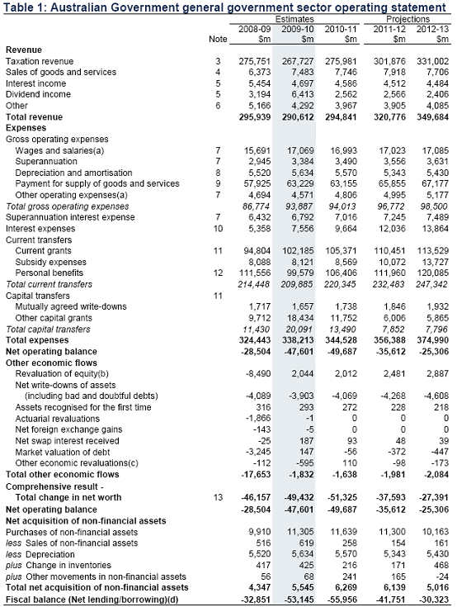
STATEMENT NINE: Financial Statements (Operating Statement)
Notes:
Statement 9: financial statements
There are two: operating statement and the balance sheet
Operating statement: FOUR COMPONENTS
1. Net operating balance: this is the difference between current revenues and current expenditure, that is, day-to-day operations
∙ For example, ‘interest expense’ is the interest paid on government borrowings
2. Other economic flows: these are NON-OPERATING EXPENSES AND REVNEUES. fOR THE MOST PART, THEY ARE book entries (for example, writing off as bad debts student loans that have not be repaid)
3. Net acquisition of non-financial assets: non-financial assets are ‘physical’ assets such as land and buildings (as distinct from ‘financial’ assets such as cash, equity in Australia Post etc)
4. Fiscal balance: this is the accrual measure of the budget deficit/SURPLUS
Obtained by adding the net operating balance to the net acquisition of non-financial assets

Slide 37
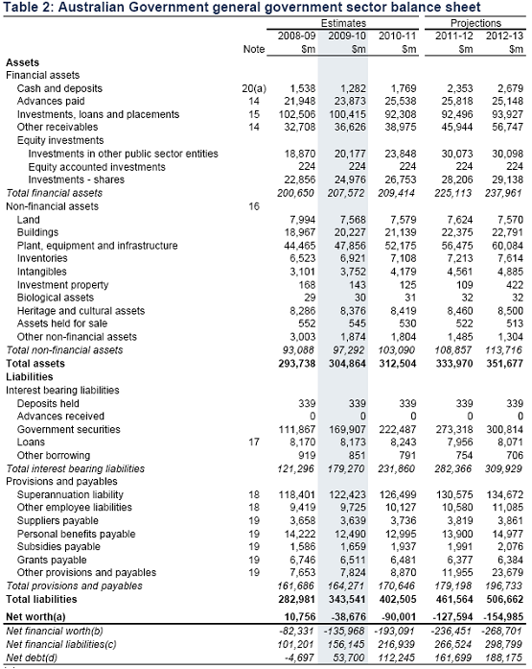
STATEMENT NINE: Financial Statements (Balance Sheet)
Notes:
BALANCE SHEET
Liabilities:
∙ Government securities: they are bonds and Treasury notes that the government has issued to help fund its activities
∙ Superannuation liability: amount owed to public servants
Note the memorandum item ‘net debt’

Slide 38
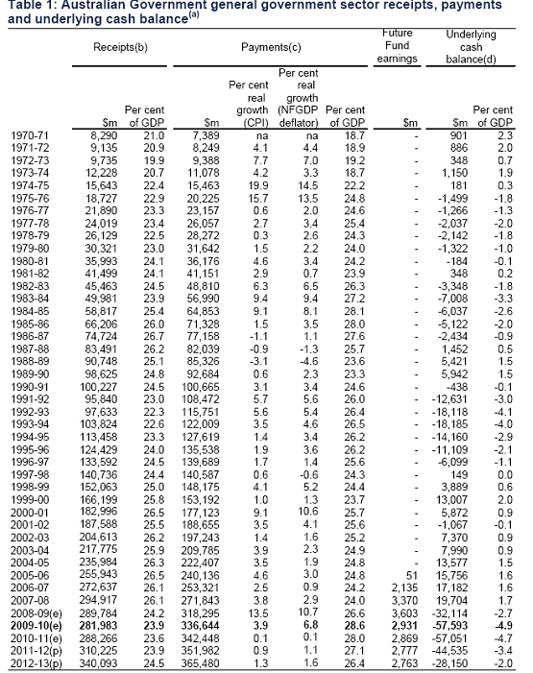
Statement 10: Historical Data

Slide 39
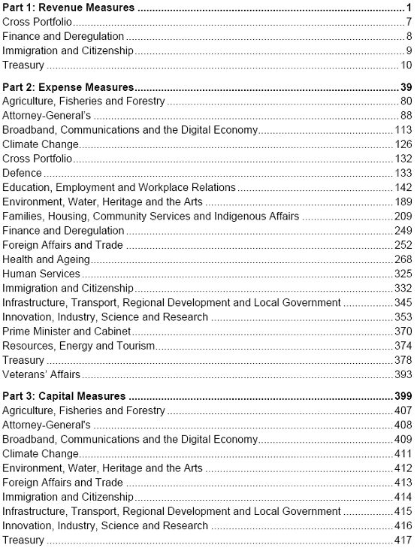
BUDGET PAPER NUMBER 2
Notes:
BUDGET PAPER NUMBER 2
THIS BUDGET PAPER DESCRIBES ALL THE MEASURES THAT THE GOVERNMENT HAS INTRODUCED BOTH IN THE BUDGET AND SINCE THE LAST MID-YEAR ECONOMIC AND FISCAL OUTLOOK (MYEFO)
BUDGET PAPER NO. 2 IS THUS A VERY QUICK AND CONVENIENT WAY OF FINDING INFORMATION ON MEASURES
BP #2 CONTAINS CHANGES IN EXPENDITURE AND REVENUE.
TO FIND LEVELS, GO TO THE PORTFOLIO BUDGET STATEMENTS

Slide 40
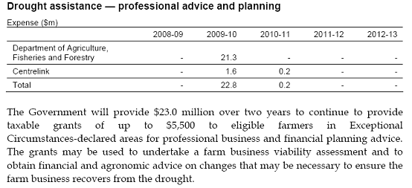
EXAMPLE OF AN EXPENSE MEASURE

Slide 41
BUDGET PAPER NUMBER 3
Part 1: Australia's Federal Relations
Part 2: Payments for Specific Purposes
Part 3: General Revenue Assistance
Part 4: Debt Transactions
Part 5: Developments in the Consolidated Non-Financial Public Sector
Part 6: Accountabilities Under the Federal Financial Relations Framework
Appendix A: Parameters and Further Information
Appendix B: Guaranteed Minimum Amount and Budget Balancing Assistance
Appendix C: Supplementary Tables
Notes:
BUDGET PAPER NUMBER 3
THIS DEALS WITH GRANTS THE COMMONWEALTH GIVES TO THE STATES AND TO LOCAL GOVERNMENTS
SO THIS IS WHERE YOU CAN FIND THE BREAK DOWN OF PAYMENTS OF THE GST TO THE STATES
IT IS ALSO WHERE THE SPECIFIC PURPOSE PAYMENTS THE COMMONWEALTH MAKES TO THE STATES FOR HEALTH, EDUCATION, ROADS ETC

Slide 42
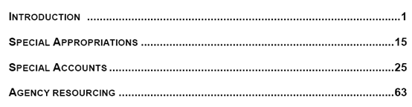
BUDGET PAPER NUMBER FOUR
Notes:
BUDGET PAPER NUMBER FOUR
THE INTRODUCTION (ONLY 14 PAGES) IS HIGHLY RECOMMENDED AS AN OVERVIEW OF HOW THE BUDGET WORKS. IT DESCRIBES THE SYSTEM OF APPROPRIATIONS, AND EXPLAINS THE JARGON
LISTS ALL SPECIAL APPROPRIATIONS, ALL SPECIAL ACCOUNTS AND SHOWS HOW AGENCIES ARE RESOURCED

Slide 43
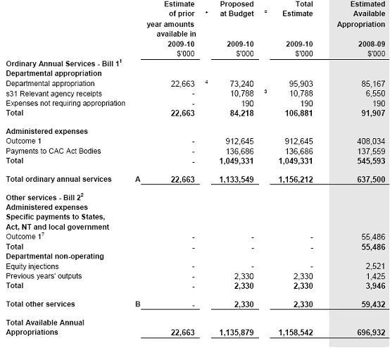
PORTFOLIO BUDGET STATEMENTS (PBS)
Notes:
PORTFOLIO BUDGET STATEMENTS (PBS)
THEY ARE THE MAIN SOURCE OF INFORMATION AT THE AGENCY LEVEL
HOWEVER, DON’T BE SURPISED IF YOU CANNOT FIND SOME OF THE INFORMATION YOU ARE LOOKING FOR
STARTING POINT IN THE PBS IS THE AGENCY RESOURCE STATEMENT. THIS SUMMARISES THE ENTIRE BUDGET FOR AN AGENCY
WILL GO THROUGH THE AGENCY RESOURCE STATEMENT FOR
DEPARTMENT OF RESOURCES

Slide 44
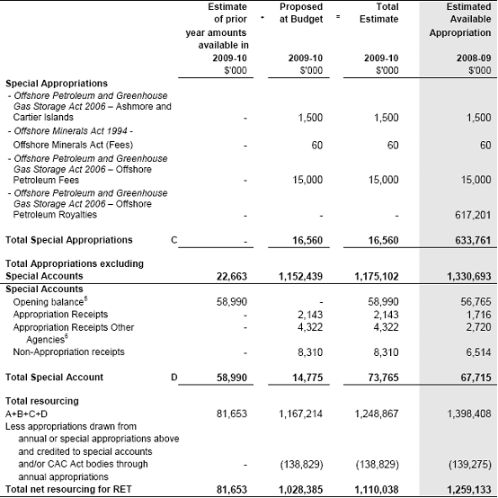
PORTFOLIO BUDGET STATEMENTS (PBS)

Slide 45
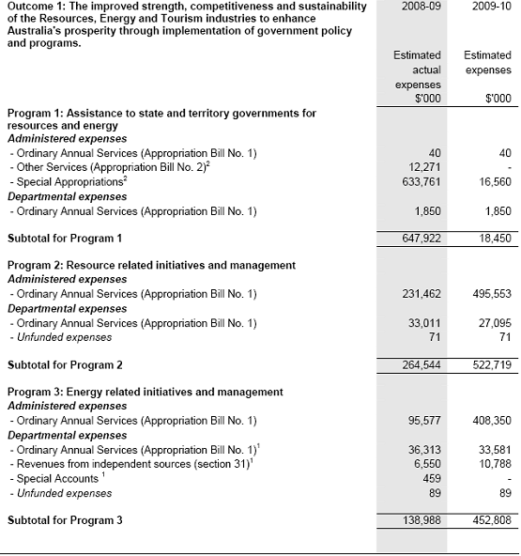
PORTFOLIO BUDGET STATEMENTS (PBS)

Slide 46
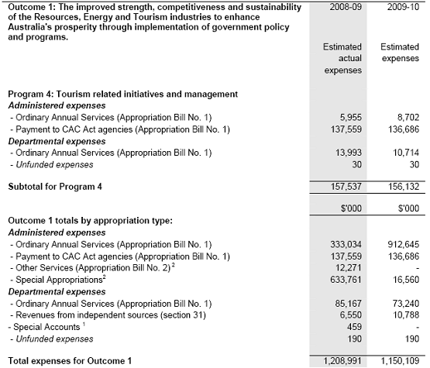
PORTFOLIO BUDGET STATEMENTS (PBS)

Slide 47
THANK YOU FOR YOUR ATTENDANCE FEEL FREE TO ASK QUESTIONS OF SCOTT, GARTH OR MYSELF
Contact Details:
Scott
6277 2455
scott.kompo-harms@aph.gov.au
Garth (until 30 June 2010)
6277 2437
garth.day@aph.gov.au
Richard
6277 2464
richard.webb@aph.gov.au

