Slide 1
Dr. Regina Betz Parliamentary Library Vital Issues Seminar Carbon Tax and Emissions Trading Canberra, Tuesday 17 March
Climate Policy: Comparing cap and trade and tax schemes

Slide 2
Overview
Coherent Climate Change Policy Mix
Tax versus Cap and Trade
Theoretical comparison
Practical experiences
International aspects
Voluntary action
Recession
Conclusions

Slide 3
There are three main pillars of climate change policy
Emissions trading or carbon taxes – as part of a carbon pricing policy – is just one pillar
Neuhoff (2008)

Slide 4
A coherent and effective policy mix
Drivers of emissions reductions | Informational and regulatory approaches Information disclosure Auditing Technical Regulation | Economic instruments: Subsidies and taxes Environmental ‘designer’ Markets | Innovation instruments : Market engagement programmes Strategic R&D, demonstration and deployment Infrastructure program
Behavioural changes
Substitution effects
Technical innovation
Different drivers and concerns imply different instruments
Source: Adopted from Grubb 2006
Notes:
But for the required change we need even more policies. Even as a economist a agree that a cap and trade scheme which delivers a price signal is not the only policy we need. This is because the market failure has different sources. This table shows you what the policy mix should look like.
AS said before for technical innovation it is a mixture of innovation instruments (push) and economic instruments (pull). For substitution of fuels we see economic instruments are working well and to achieve behavioural change e.g. energy efficiency we need more policies in the area of information and regulation.
CEEM is working in all of those areas

Slide 5
Carbon pricing rewards individuals and firms that reduce emissions.
Carbon price creates incentives for the use of more carbon efficient technologies
Induces substitution towards lower carbon fuels, products and services by industry and consumers
It also creates market potential for low carbon and energy efficient innovation.
To deliver this outcome the carbon price has to feed through the economy.
This builds on extensive empirical evidence: energy prices drive energy efficiency.
Carbon pricing is a challenging, but indispensable, component of climate policy.
Neuhoff (2008)

Slide 6
Emissions trading and carbon taxes are theoretical twins or ‘duals’
Both set a price on emissions
Both aim at achieving emission reductions from where they are least costly.
Under idealised conditions (including no uncertainty) they are equally effective.
Price of carbon permit = carbon tax rate
Under uncertainty (of mitigation costs or damage costs) it depends on the relative slope of the curves:
Considering atmospheric stock of gases that drive climate change damage curve is flat: carbon taxes more efficient instrument
Taking tipping points into account marginal benefits are potentially very steep: emission trading scheme more efficient option

Slide 7
Emissions Trading and Carbon Taxes share a range of considerations
Setting targets: “It is neither easier or harder to name the right price than the right quantities because in principle exactly the same information is needed to correctly specify either” (Weitzman, 1974) –> Climate Science delivers quantities
Energy intensive trade exposed industries – same problem
Stranded assets – e.g. coal – same problem
Low income distributional impacts – same problem
Investment decisions – uncertainty of price in ETS could become trial and error of carbon tax to achieve specific target (who bears the uncertainty?)

Slide 8
EU Emissions trading scheme
Participation
27 participating countries (+3 Norway, Lichtenstein and Iceland)
All electricity, ferrous metals, pulp & paper, cement and all facilities > 20MW, total 46% of EU emissions
International Link via limited use of Kyoto Units in all Phases
Timing:
Started 2005
Pilot Phase (2005-2007), Phase 2 (2008-2012= Kyoto), Phase 3 (2013-202)
Full flexibility (banking / borrowing) within a period, no banking from pilot phase to phase 2
Cap, Allocation and sanctions
Phase 1+2: Cap & allocation left to the Member States (National Allocation Plans), approval by the European Commission: Mainly free allocation
Phase 3: Central cap setting, -21% compared to 2005, around 60% auctioning 2013, increasing over time
100 €/t CO2 (from 2008), no buy-out, no safety valve
Lessons learnt:
Abatement can be proved for the pilot phase (when there was an EUA price)
Emission reduction resulted more from ‘unexpected’ sources (coal-to-coal shift, biomass co-firing) than from the ‘conventional’ fuel shift
Cap setting important and free allocation complex

Slide 9
Environmental taxes
Carbon tax in Norway (Bruvoll and Larsen 2004)
Introduced in 1991
highest carbon tax rate was US$51 per tonne CO2 in 1999, and the average tax was US$21 per tonne CO2
Despite carbon tax CO2 increased by 19 percent from 1990 to 1999 but GDP growth of 35 percent
Small effect of carbon taxes on emission-reducing components (total 2.3%, on-shore only 1.5%)
Reason: exemption for a broad range of fossil fuel intensive industries (e.g. fishing, agriculture, land-based gas use, metals refining, cement, and several others) principally motivated by concern about competitiveness
Eco tax in Germany
Introduced 1999
Apart from reducing energy consumption aim to generate revenue to lower burden on labour costs to increase employment
Mineral oil and electricity tax (excludes coal!!)
Net burden cap for manufacturing industry: Refund of full eco tax if tax burden is 1.2 of the savings received through social security payment
Administration costs of exemptions can be very high!!

Slide 10
International Agreements
Coming to any global agreement is extremely difficult – whether global cap-and-trade or harmonized carbon tax policies
However, the former is probably more likely and there is institutional inertia and important lessons already learned.
Kyoto Mechanism may help to achieve a unique carbon price internationally through indirect linkiages
The EU failed with a carbon tax
The Scandinavians, which do have some carbon taxes, have also never harmonised schemes
Setting different carbon tax levels is inefficient

Slide 11
‘Voluntary’ action incentives debate – some clarifications
Ethically driven voluntary reductions (beyond price driven motives) are relatively small
The CPRS is not a ‘zero-sum game’ or ‘carbon pollution reallocation scheme’
To reach the cap from business-as-usual requires significant carbon reductions → these net savings are not displaced by ‘big polluters’.
Under Treasury scenarios, the Australia carbon price is usually set by the international CDM price, so adding, say, a voluntarily solar panel has little effect on this price and thus industry pollution → Rather there are less purchases overseas credits and Australian emissions are reduced (but not globally).
Those voluntary actions increase the capacity for reductions in the long run and allow for a tighter cap when reset.
Reductions are available through retirement funds and, for example, planting trees (that have not opted into the scheme).
A reserve to be set aside to lead to a more stringent target should be considered
Tax under the cap of Kyoto will also need government support e.g. retirement of Assigned Amount Units

Slide 12
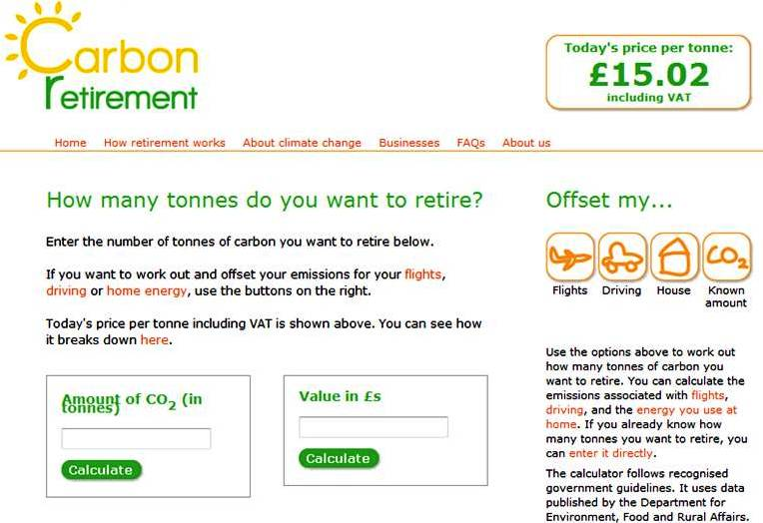
European example of a carbon retirement site

Slide 13
What about the recession?
An ‘emissions pause’ in the short term
Kyoto (2008-12) compliance easier
But no likely change in emission intensity (Emission/GDP)
Emission trading is counter-cyclical → lower carbon prices with lower economic growth (as evident in the EU ETS carbon price fall recently)
Likely followed by resumption of business-as-usual carbon intensive growth …unless mitigation policies in place
2020 targets remain a significant challenge.
“We must not let the financial and economic crisis distract our attention from moving towards long-term rational climate policies.” – OECD Secretary-General

Slide 14
Conclusions
Comparison of implemented tax schemes with implemented emissions trading scheme: differences vanish
Emission trading schemes have worked but needed improvement
Taxes have only shown limited success in reducing emissions and a lot of exemptions which have not been reduced over time
Success of reducing emissions depends on the stringency of the target or the level of the tax (what is more likely to be achieved?)
Multi-national schemes are possible as illustrated by EU
Many of the problems with emissions trading that have been highlighted by commentators (the target, EITEI, Coal) will be present with a carbon tax
The latest science increasingly emphasizes the urgency of the issue and the need to act now, therefore do not waste time by discussing taxes vs. ETS
Use the time to design the coherent POLICY MIX we need!

Slide 15



Thank you… more information on our website… subscribe to our email updates and newsletter…
www.ceem.unsw.edu.au

