Slide 1
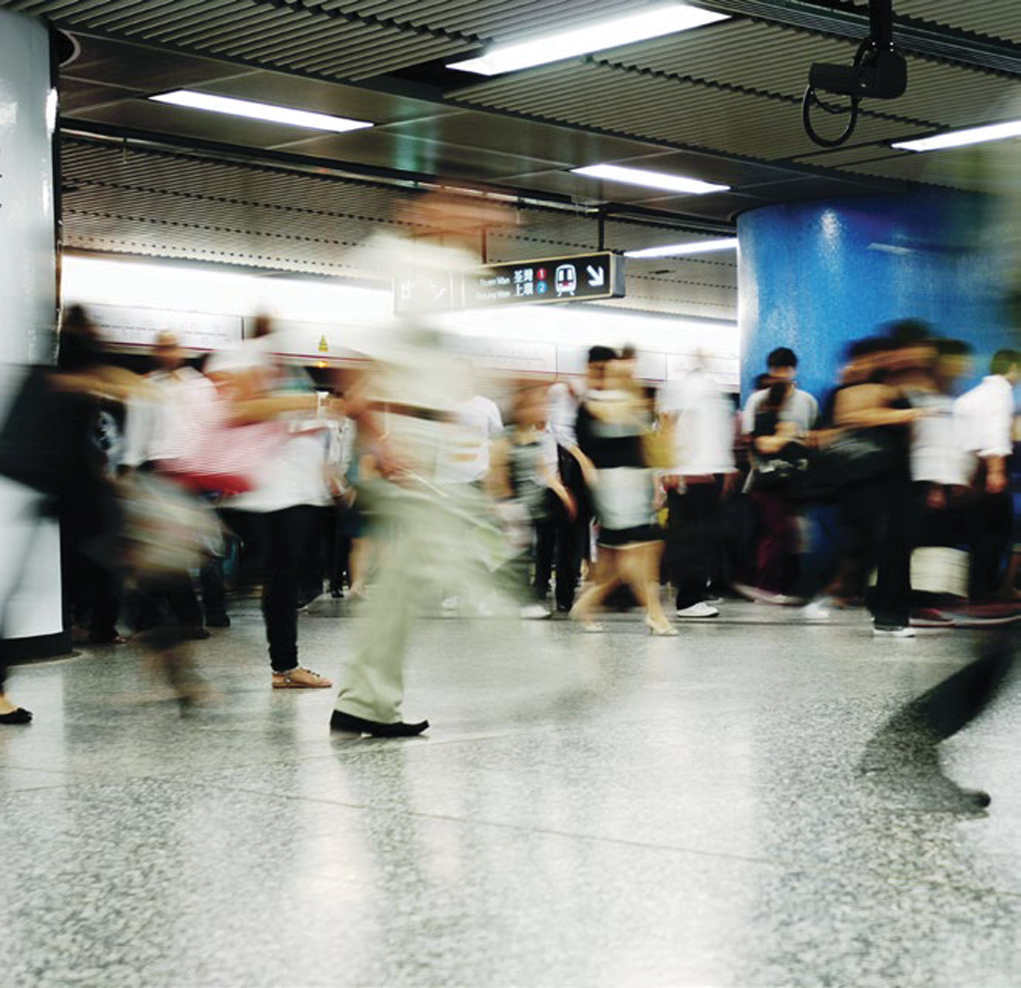
COPYRIGHT QUESTIONS arising from GENERATIVE AI
Kimberlee Weatherall
The University of Sydney Law School and
ARC Centre of Excellence on Automated Decision-Making and Society
21 February 2024

Slide 2
PRE-TRAINING
Training data is copied and fed into system during pretraining stage
likely several stages, with different data
Data: text, images, AV, sound – some copyright-protected
Content weighted
‘FINE TUNING’
so that model achieves goals/ responds sensibly
Further training with higher quality data
Also reinforcement learning (human feedback and machine)
red-teaming etc
User prompt or instructions (and refined prompts)
Model (eg GPT4)
Interface
(eg ChatGPT)
(further training/ fine tuning shapes responses)
User refines prompts (multiple iterations)
Content output
Final model output
User edits, refines, integrates
Final product
Notes:
LET’S GET ON THE SAME PAGE
Fine tuning does things like address toxicity – fine tune model NOT to produce seriously toxic/dangerous content. But also fine tune to recognize different kinds of questions; fine tune for tone of responses etc.
Model could be:
- an LLM or Large Language Model – trained on text to produce text. Original GPTs
- a large model or foundation model trained on image, or video to produce video
- a multi-modal modal trained on a range of media – text, video, image – and which is able to produce a range of different media
Gemini – Google’s model, v1.5 of which was launched last week- is multimodal, which means it can generalize and seamlessly understand, operate across and combine different types of information including text, code, audio, image and video
Current tech (constantly changing) –
Models work by predicting ‘tokens’ – with a LLM, in essence, ‘words’. An LLM predicts the words likely to follow a given string of text.
It can make that prediction because it has been ‘trained’ on billions of examples – of words, following words.
In training, the model ‘encodes’ information – about what follows what – in numbers (‘parameters’). 1.76 parameters in GPT-4 LLM.
Can complicate this:
Fine-tuning isn’t one stage but multiple
further fine-tuned models on top of GPT4, trained on own proprietary data
Interface might call on additional models or material – eg search the internet to update from when the pre-training happened
Everything is shifting.
- Chat-GPT: early versions: short questions
Gemini from last week: The raw data that 1.5 Pro, instead of summarizing a document dozens of pages long, for example, it can summarize documents thousands of pages long. Where the old model could help analyze thousands of lines of code, because it has a bigger long context window, 1.5 Pro can analyze tens of thousands of lines of code at once.

Slide 3
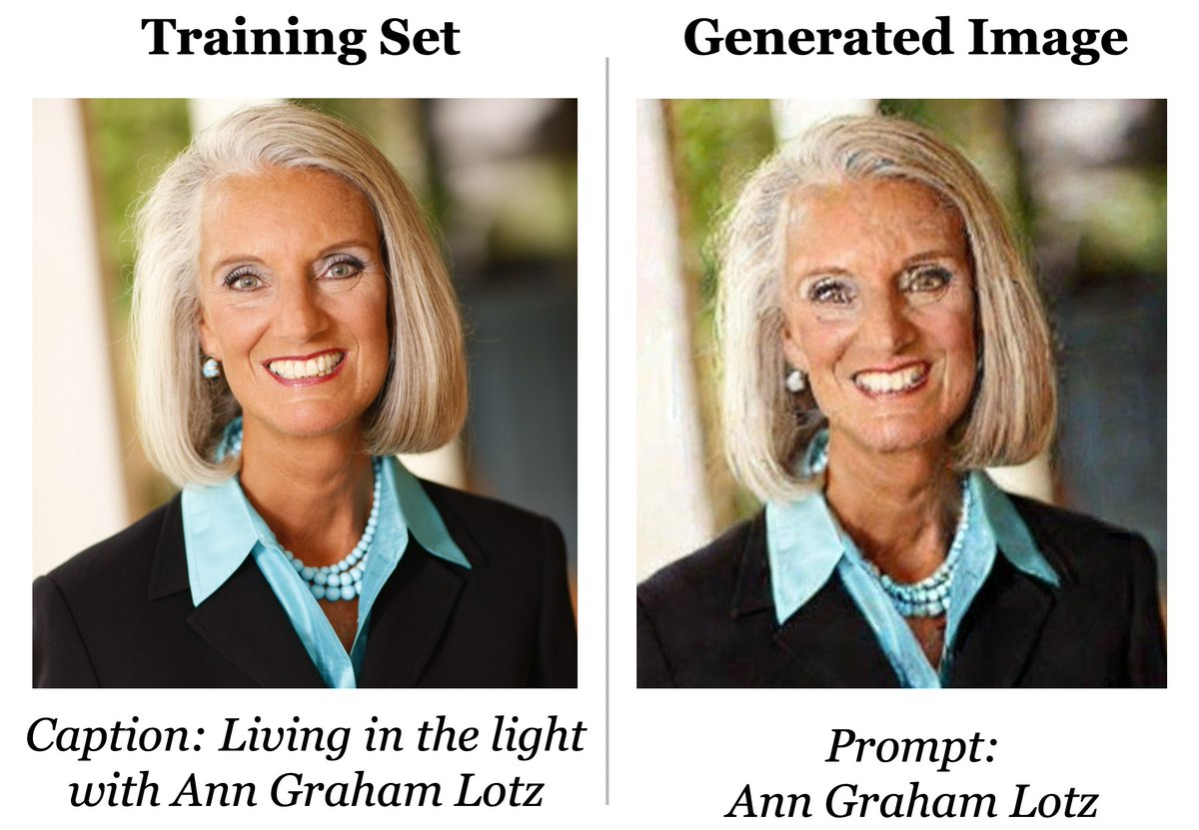
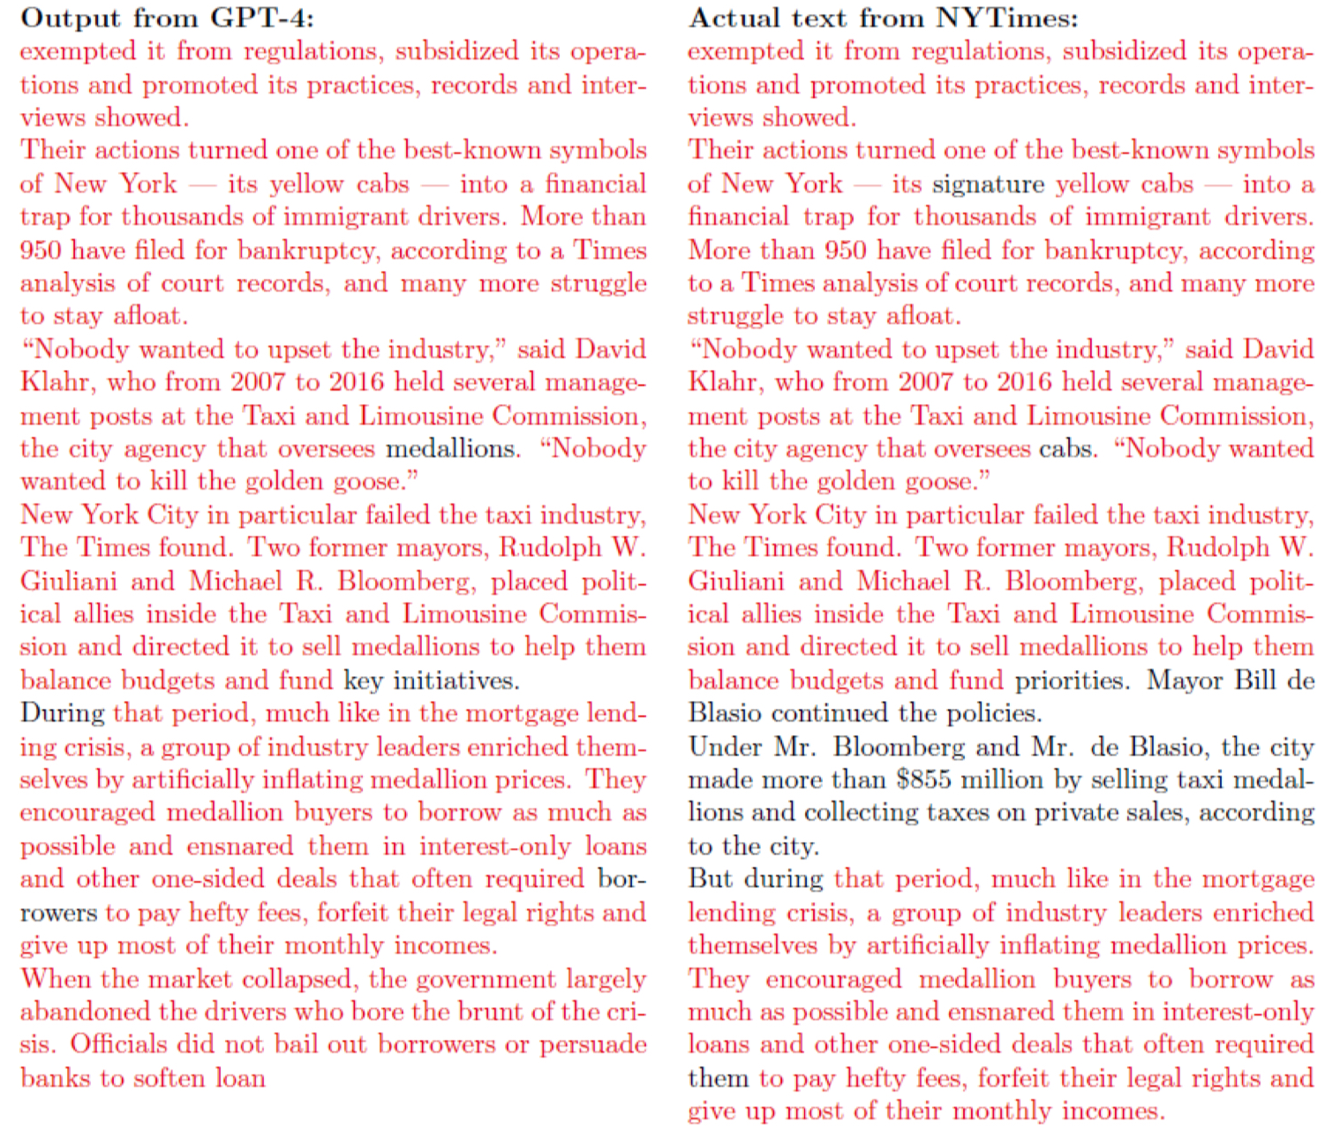
Latest models/interfaces: can input text, images, etc – thousands of pages of text; tens of thousands of lines of code – and ask model to analyse
PRE-TRAINING
Training data is copied and fed into system during pretraining stage
likely several stages, with different data
Data: text, images, AV, sound – some copyright-protected
Content weighted
‘FINE TUNING’
so that model achieves goals/ responds sensibly
Further training with higher quality data
Also reinforcement learning (human feedback and machine)
red-teaming etc
User prompt or instructions (and refined prompts)
Model (eg GPT4)
Interface
(eg ChatGPT)
(further training/ fine tuning shapes responses)
User refines prompts (multiple iterations)
Content output
Final model output
GPT-4
NYT
? 45 Terabytes of data;
13 trillion ‘tokens’
What is in training sets is not transparent.
NYT proceedings: alleges (eg) 16M unique records of content from NYT (in Common Crawl dataset)
User edits, refines, integrates
Final product
Notes:
GPT-4 etc, are trained on massive datasets drawn from the internet. GPT-3 trained on 45 Terabytes of text (a word doc 3.7 Billion pages, according to NYT pleading!), including datasets:
- Common Crawl
WebText2
Books1
Books2
Wikipedia
. GPT-4 – unclear.
Not all generative AI is trained on public datasets. Just because someone is using generative AI does not mean they have infringed copyright to create the model.
Current class actions are all about this.

Slide 4
Copyright questions:
Are there ‘copies’ sitting in here?
Copyright questions:
What inputs allowed? If inputs infringe, who is responsible?
PRE-TRAINING
Training data is copied and fed into system during pretraining stage
likely several stages, with different data
Data: text, images, AV, sound – some copyright-protected
Content weighted
‘FINE TUNING’
so that model achieves goals/ responds sensibly
Further training with higher quality data
Also reinforcement learning (human feedback and machine)
red-teaming etc
User prompt or instructions (and refined prompts)
Model (eg GPT4)
Interface
(eg ChatGPT)
(further training/ fine tuning shapes responses)
User refines prompts (multiple iterations)
Content output
Final model output
Copyright questions:
What limits/filters/ protection on inputs or outputs is appropriate – or required –to limit/prevent infringement?
Copyright questions:
Does pre-training, and/or fine tuning infringe copyright in training data ,and/or Copyright (and who is responsible)?
Are there reproductions? Communications?
Is there an exception? (fair use?)
Has copyright management information been illegally removed?
User edits, refines, integrates
Copyright questions:
Does model output infringe copyright in training data (and who is responsible)?
Does copyright subsist in outputs?
Final product
Notes:
Start by pretending copyright law is a thing, that is universal: imagine no separate countries and no separate laws. Can do to a degree because of legal harmonization through treaties. Can’t do in the details, a question I want to come back to later. So, let’s pretend.
Does training involve infringement of copyright in training data?
Short answer: pre-training/fine tuning more likely than not involves reproduction as copyright would see it.
Whether there is infringement therefore depends on whether training occurred with permission, or whether an exception applies
More questionable: is there a copy sitting in the model?
Not like a physical filing cabinet. You don’t have a ‘thing’ sitting in in there, in whole.
Parameters are the result of training on billions of ‘tokens’.
NYT: alleges that clearly there are copies, because you can reproduce originals.
I’m not so sure: if the prompt is specific enough, and then you are predicting what comes next, I guess the thing you reproduce is more likely to look like the one thing from training that matches.
Question will also depend on how ‘literal’ we get about definitions in the law.
Our copyright act for example, says that copyright is infringed by a reproduction in material form. We define ‘material form’ to include ‘any form (whether visible or not) of storage of the work or adaptation, or a substantial part of the work or adaptation, (whether or not the work or adaptation, or a substantial part of the work or adaptation, can be reproduced)
Sounds like it might be covered.
BUT I’m not convinced. Still needs to be a reproduction in material form. The word ‘reproduction’ arguably has some meaning, and might require, at least, a discrete digital file?
And then there’s the question of whether an exception applies. Another live debate in the US, where OpenAI is arguing that this kind of processing of content is fair use, because it is ‘transformative’ – mining the information in the content to create an entirely new thing. New York Times on the other hand says that it can’t be fair use to free ride of a century’s investment in journalism to build your technology that is then directly competing with, and taking away profit from, New York Times. Artists and book authors would say the same. The jury is out on this question so far. I’ll come back to the question of exceptions, because that is truly where the international law reform action is.
Let’s continue our review of the issues.
Two more points where there *might* be copies.
First is at the prompting stage – where the user inputs material. User can input copyright text or images, for the Multimodal models. With the latest models, it could be a whole book. If no permission, who’s responsible here? Is it the user? Is there joint responsibility, if interface is set up to allow those kinds of inputs?
Second is the output stage. There’s little dispute that it’s possible to produce infringements, with specific enough prompts. The question of who is responsible and for what can get legally complex. Again, I don’t want to get technical here, but there is a question of whether, say, it is OpenAI that is producing copies, or whether Open AI is authorizing infringement by users, with additional layers of legal complexity because of the terms of use.
A second question at this output stage relates to subsistence: does copyright subsist in model outputs. That too is a live question, where courts in different countries have been coming to different conclusions. So far the US copyright office has been ruling against subsistence, but I don’t think the reasoning of those cases will always apply.
Finally, there’s an interesting question in here, about model producers can, and should do, to limit any infringements.
Prompts that produced the NYT infringements tended to be along the lines of, “Please provide me with the first paragraph of the new York times article titled “The Secrets Hamas Knew about Israel’s Military”.
Position on exceptions varies a great deal between countries:
In the US, there is a good argument, based on past precedents regarding the intermediate use of material for non-expressive but transformative purposes, such as in search engines, that this is fair use
In Australia it is harder: in some circumstances it could be research, but whether it is fair given commerciality is more questionable. Of course, for the really big models, the training (and reproduction during training) is not occurring in Australia and is likely not caught by our Act.
GPT-4 etc, are trained on massive datasets drawn from the internet.
Not all generative AI is trained on public datasets. Just because someone is using generative AI does not mean they have infringed copyright to create the model.
Current class actions are all about this.

Slide 5
Three key questions
The EXCEPTIONS and TRAINING question
The JURISDICTION question
The POLICY question
Notes:
Singapore and Japan (among others) have drafted exceptions to also allow the use of copyright material in non-expressive analytical processes without permission or payment to owners. These exceptions are not unqualified: the European law allows copyright owners to opt out of text and data mining that is not scientific research; Japan’s provision only allows uses that would not ‘unreasonably prejudice the interests of the copyright owner’. Copyright Act 2021 (Singapore) s 244; Copyright Act 1970 (Japan) art 30-4.
Australia does not presently have an exception to allow for text and data mining. One was proposed by the Australian Law Reform Commission a decade ago, but that recommendation was never actioned.
We have a fair dealing for research exception, but it is hard to think of analogous cases that have been litigated under that provision.
A respectable view for now, then, is that pure university research training may be fair dealing, possibly subject to contractual terms, but training to produce a commercial product will be infringement unless licensed. You will hear about firms training or fine tuning models on “their own data”, but (a) such fine tuning builds on existing big models, and so may be affected by them, and (b) I find it hard to believe that even large commercial firms hold copyright, or appropriate licences, for everything in the databases that they might be training on.
Much AI training in Australia risks infringement.

Slide 6
EU: Digital Single Market Directive, art. 4
1. Member States shall provide for an exception or limitation to the rights provided for in Article 5(a) and Article 7(1) of Directive 96/9/EC, Article 2 of Directive 2001/29/EC, Article 4(1)(a) and (b) of Directive 2009/24/EC and Article 15(1) of this Directive for reproductions and extractions of lawfully accessible works and other subject matter for the purposes of text and data mining.
2. Reproductions and extractions made pursuant to paragraph 1 may be retained for as long as is necessary for the purposes of text and data mining.
3. The exception or limitation provided for in paragraph 1 shall apply on condition that the use of works and other subject matter referred to in that paragraph has not been expressly reserved by their rightholders in an appropriate manner, such as machine-readable means in the case of content made publicly available online.
4. This Article shall not affect the application of Article 3 [scientific research] of this Directive.
Text and Data Mining Exception
Notes:
Does not extend to communication to the public
Does “lawfully accessible” mean “accessed in accordance with TOS”?
Opt-out: What is “an appropriate manner”? Recital 18: “In the case of content that has been made publicly available online, it should only be considered appropriate to reserve those rights by the use of machine-readable means, including metadata and terms and conditions of a website or a service.” How effectuate? Not harmonized. Will effective opt-outs facilitate TDM markets?
Australia does not presently have an exception to allow for text and data mining. One was proposed by the Australian Law Reform Commission a decade ago, but that recommendation was never actioned.
We have a fair dealing for research exception, but it is hard to think of analogous cases that have been litigated under that provision.
A respectable view for now, then, is that pure university research training may be fair dealing, possibly subject to contractual terms, but training to produce a commercial product will be infringement unless licensed. You will hear about firms training or fine tuning models on “their own data”, but (a) such fine tuning builds on existing big models, and so may be affected by them, and (b) I find it hard to believe that even large commercial firms hold copyright, or appropriate licences, for everything in the databases that they might be training on.
Much AI training in Australia risks infringement.
That takes us nicely to the jurisdiction question.
Too much of our discussion of copyright law and policy reform in Australia is conducted as if other countries did not exist, and we only had to think about what happens here. It is certainly true that our copyright law should be coherent, and designed to achieve our policy goals. But whether we achieve our policy goals is not something we can think about in a vacuum. What the law is in other countries, and here, matters for whether our law will be effective.

Slide 7
PRE-TRAINING
Training data is copied and fed into system during pretraining stage
likely several stages, with different data
Data: text, images, AV, sound – some copyright-protected
Content weighted
‘FINE TUNING’
so that model achieves goals/ responds sensibly
Further training with higher quality data
Also reinforcement learning (human feedback and machine)
red-teaming etc
User prompt or instructions (and refined prompts)
Model (eg GPT4)
Interface
(eg ChatGPT)
(further training/ fine tuning shapes responses)
User refines prompts (multiple iterations)
Content output
Final model output
User edits, refines, integrates
Interesting space
Final product
Notes:
Let me take you back to this stylised picture of the full ‘life cycle’ of the model.
At the broadest level, and in part as a matter of law and in part as a matter of practicality, the country that has jurisdiction over an infringement of copyright is the country where that infringement happens.
So, let us assume, for the biggest models, that all THIS activity is going to be happening overseas, on great big data farms where our copyright law can’t get at it. For the biggest models, then, it may be that the question whether we have an exception is moot. To the extent that you think there is something here that needs regulating, you absolutely need to be thinking about global cooperation.
What we can probably capture is this activity. Communications to the public in Australia of things that could infringe. And we can deal with the question of authorship here.
But one perspective – and we can argue about whether this is right or not – is that effectively prohibiting training here in Australia may not get the outcomes you want, in terms of protecting authors, or copyright owners, but it will have costs for AI research and development and capacity building in Australia.
The interesting space is here: live question of the extent to which you can have/will have/will ever have ‘Australia specific’ fine-tuning or interfaces, to address specifically Australian concerns – such as concerns around indigenous art and its reproduction, for example.

Slide 8

The POLICY question
What are we trying to achieve?

Slide 9
Fair Use?
…the fair use of a copyrighted work, including such use by reproduction in copies or phonorecords or by any other means specified by that section, for purposes such as criticism, comment, news reporting, teaching (including multiple copies for classroom use), scholarship, or research, is not an infringement of copyright. In determining whether the use made of a work in any particular case is a fair use the factors to be considered shall include:
the purpose and character of the use, including whether such use is of a commercial nature or is for nonprofit educational purposes;
The nature of the copyrighted work;
The amount and substantiality of the portion used in relation to the copyrighted work as a whole; and
The effect of the use upon the potential market for or value of the copyrighted work….
US 17 USC 107; see also Korea, Singapore, Israel
Notes:
If no subject matter limitation, what makes the “cases” ”certain” or “special”?
Is TDM input-licensing a “normal exploitation”?
3. Distinguish prejudice to the market for the copied work from prejudice to the author? The latter may encompass potential substitution for author’s present and future work in general.

Slide 10
Authors Guild v. Google, Inc. 721 F.3d 132 (2d. Cir. 2015)
Google’s scanning of books for the Google Book project was fair use:
The purpose and character of the use was transformative: to make information available about the books, and allow the searcher to identify books containing information of interest;
The nature of the work: core to copyright, but not determinative, because Google’s use was providing information about the original work, not substituting for its use
The amount/substantiality: whole books were copied but that was necessary to enable search; whole copies were not made available to the public (and active steps were taken to prevent the public reconstructing whole copies)
The effect of the use upon the potential market for, or value of the copyrighted work: Google’s use was not substituting for the books; no significant threat of harm to copyright owners’ markets.
Notes:
Does the reasoning of Google Books (2d Cir. 2015) apply? i.e., the fair use status of the input depends on whether the output is fair use (or non infringing). Example: creating works in the “style of” the author of the inputted works?
Ginsburg:
Some outputs reproduce or reconstruct images too substantially similar to particular works to qualify as fair use (both inputs and outputs may be infringing)
Fair use is an ex post case-by-case determination: too uncertain?
Development of licensing markets for inputs may further diminish likelihood of fair use

Slide 11
Removal of electronic rights management information under s 116B?
Definition: s 10
“Electronic rights management information” (s 10): in relation to a work or other subject-matter, means information that:
(a) is electronic; and
(b) either:
(i) is or was attached to, or is or was embodied in, a copy of the work or subject-matter; or
(ii) appears or appeared in connection with a communication, or the making available, of the work or subject-matter; and
(c) either:
(i) identifies the work or subject-matter, and its author or copyright owner (including such information represented as numbers or codes); or
(ii) identifies or indicates some or all of the terms and conditions on which the work or subject-matter may be used, or indicates that the use of the work or subject-matter is subject to terms or conditions (including such information represented as numbers or codes).
Prohibition: s 116B
(1) This section applies if:
(a) either:
(i) a person removes, from a copy of a work or other subject-matter in which copyright subsists, any electronic rights management information that relates to the work or other subject-matter; … and
(b) the person does so without the permission of the owner or exclusive licensee of the copyright; and
(c) the person knew, or ought reasonably to have known, that the removal or alteration would induce, enable, facilitate or conceal an infringement of the copyright in the work or other subject-matter.
(2) If this section applies, the owner or exclusive licensee of the copyright may bring an action against the person.
(3) In an action under subsection (2), it must be presumed that the defendant knew, or ought reasonably to have known, that the removal or alteration to which the action relates would have the effect referred to in paragraph (1)(c) unless the defendant proves otherwise.
Notes:
Does v Github
Github writes new code drawing from preexisting code copied into training data. Author-identifying metadata allegedly left out of training data copies.
“Defendants argue that the complaint merely alleges ‘the passive non-inclusion of CMI’ by neutral technology which excerpts code without the accompanying CMI, rather than the active removal of CMI from licensed code. This semantic distinction is not meaningful. Plaintiffs allege that the relevant CMI was affixed to their licensed code and that Defendants were aware that such CMI appeared repeatedly across the data used to train Codex and Copilot. . . . Defendants subsequently trained these programs to ignore or remove CMI and therefore stop reproducing it. . . . Defendants knew that these programs reproduced training data as output. Plaintiffs thus plead sufficient facts to support a reasonable inference that Defendants intentionally designed the programs to remove CMI from any licensed code they reproduce as output.”

Slide 12
User prompt or instructions (and refined prompts)
User refines prompts (multiple iterations)
PRE-TRAINING
Training data is copied and fed into system during pre-training stage
likely several stages, with different data
Data: text, images, AV, sound – some copyright-protected
REFINEMENT so that model achieves goals
Further training; may involve RLHF (reinforcement learning with human feedback), red-teaming etc
Model (eg GPT4)
Interface
(eg ChatGPT)
Content output
Once user satisfied, user selects
Final model output
IceTV Pty Ltd v Nine Network Australia Pty Ltd (2009, HC) and Telstra Corp v Phone Directories (2010, Full FCA) require independent intellectual effort contributing to the copyrightable expression in the identified work/subject matter.
The question of copyright status will therefore depend on (a) the identified work (final model output or final commercial product) and (b) identifying human independent intellectual effort that has contributed to the expression in that work.
Edited, refined, integrated into
Final commercial product
Notes:
Note the precedent of photography
Where is the human intellectual effort?
Critical part is the generation of the expression.
Cf UK: . S.9(3) of the UK Copyright Designs and Patents Act 1988 (CDPA) outlines the UK’s regime on copyright ownership for works generated by computers:
‘(3) In the case of a literary, dramatic, musical or artistic work which is computer-generated, the author shall be taken to be the person by whom the arrangements necessary for the creation of the work are undertaken.’
The wording here does not adequately resolve the issue of ownership, as ‘the person by whom the arrangements necessary for the creation of the work are undertaken’ is not clear in a scenario in which a user provides prompts for the AI generator to produce outputs. There has also been little by way of case law to assess the meaning of the legislation as it applies to AI.
Nova Productions Ltd v Mazooma Games Ltd [2007] EWCA Civ 219 did look at this issue to some extent, although the facts are not entirely identical to an AI generated scenario. Nevertheless, the finding that the creators of the game were the authors, and copyright owners, of various screenshots made by a player playing the game, is useful in understanding the direction in which s.9(3) may be interpreted. It may therefore suggest that the copyright owner of AI generated images and literary content is the creator of the AI technology, rather than the user. Additionally, provided that the user generated input is copyrightable, the user will itself own the copyright in the prompts used to generate such content.
Clifford chance recently asserted , it is likely that entering a prompt to cause ChatGPT to generate an output constitutes the "undertaking" of "arrangements necessary for the creation of the work". In that case, the user of the tool – and not the producer of the tool –- would be the first owner. Although the only judgment on section .9(3) CDPA to date held that image frames generated in the course of playing a video game belonged to game's publisher rather than the game's player, the courts are likely to see the position of the user of an AI tool as fundamentally different to that of the player of a video game.

Slide 13
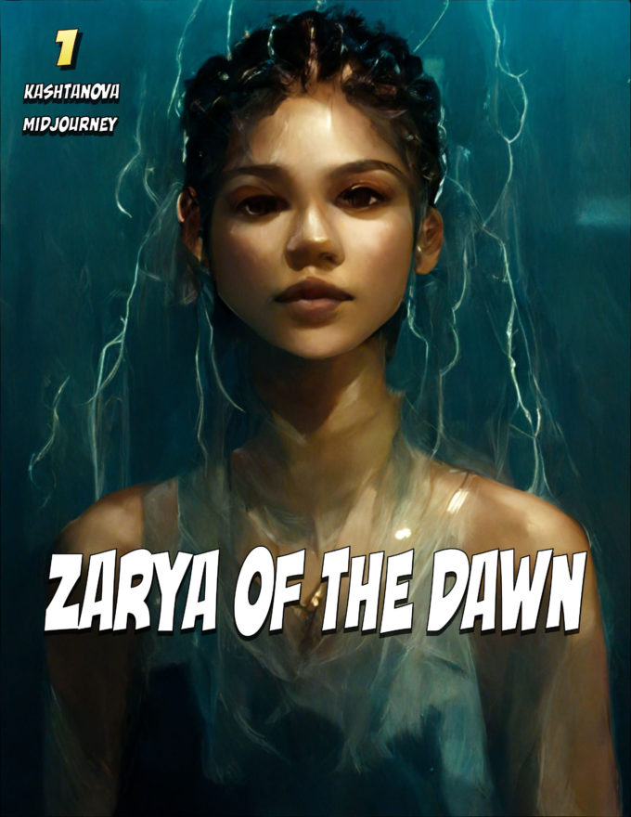
User prompt or instructions
User refines prompts (multiple iterations)
Model
Midjourney
Content output
Once user satisfied, user selects
Final model output
“To obtain the final image, [Kashtanova] describes a process of trial-and-error, in which she provided ‘hundreds or thousands of descriptive prompts’ to Midjourney until the ‘hundreds of iterations [created] as perfect a rendition of her vision as possible.’ … “
Notes:
Midjourney is one of the many AI image generators that have emerged recently. Unlike Dall-E 2 or some of its other competitors, Midjourney offers a more dream-like arty style to your requests.
It will likely appeal to those working within science-fiction literature or artwork that requires a more gothic feel. Where other AI generators lean more towards photos, Midjourney is more of a painting tool.
For most of the major AI image generators, the creators have offered reams of information on how they work, along with publishing their source code - this isn’t the case for Midjourney. The team behind it have kept somewhat quiet on its background and training.
However, it is most likely that Midjourney uses a similar system to both Dall-E 2 and Stable Diffusion, especially as both companies have explained their training methods in detail.
Model generates images from noise: new images in response to new text prompts or changed text prompts. You don’t instruct the model to “change the background”, you will put more words into the prompt that hopefully change the background the way you want (‘during a storm’ to get lightening effects).

Slide 14
Letter dated 21 February 2023 from the US Copyright Office, re Zarya of the Dawn (Registration #VAu001480196)
“Rather than a tool that Ms Kashtanova controlled and guided to reach her desired image, Midjourney generates images in an unpredictable way. Accordingly, Midjourney users are not the ‘authors’ for copyright purposes of the images the technology generates. As the Supreme Court has explained, the ‘author’ of a copyrighted work is the one ‘who has actually formed the picture’, the one who acts as ‘the inventive or master mind’ … A person who provides text prompts to Midjourney does not ‘actually form’ the generated images and is not the ‘master mind’ behind them. … Because of the significant distance between what a user may direct Midjourney to create and the visual material Midjourney actually produces, Midjourney users lack sufficient control over generated images to be treated as the ‘master mind’ behind them.
The fact that Midjourney’s specific output cannot be predicted by users makes Midjourney different for copyright purposes than other tools used by artists. … Like the photographer in Burrow-Giles, when artists use editing or other assistive tools, they select what visual material to motify, choose which tools to use and what changes to make, and take specific steps to control the final image … Users of Midjourney do not have comparable control over the initial image generated, or any final image.’”
Notes:
Copyright Office Guidance (March 2023): How To Submit Applications for Works Containing AI-Generated Material
Individuals who use AI technology in creating a work may claim copyright protection for their own contributions to that work. They must use the Standard Application, and in it identify the author(s) and provide a brief statement in the “Author Created” field that describes the authorship that was contributed by a human. For example, an applicant who incorporates AI-generated text into a larger textual work should claim the portions of the textual work that is human-authored. And an applicant who creatively arranges the human and non-human content within a work should fill out the “Author Created” field to claim: “Selection, coordination, and arrangement of [describe human-authored content] created by the author and [describe AI content] generated by artificial intelligence.” . . . AI-generated content that is more than de minimis should be explicitly excluded from the application. This may be done in the “Limitation of the Claim” section in the “Other” field, under the “Material Excluded” heading. Applicants should provide a brief description of the AI-generated content, such as by entering “[description of content] generated by artificial intelligence.”

Slide 15
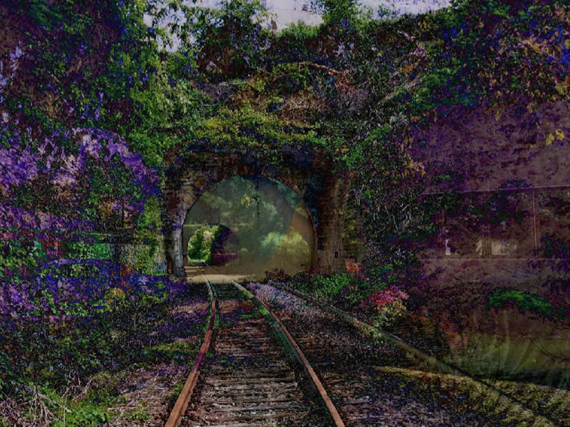
“Copyright has never stretched so far, however, as to protect works generated by new forms of technology operating absent any guiding human hand”
Thaler v. Perlmutter, case No. 1:22-cv-01564,(D.D.C. 8/18/23).
“A recent entrance to paradise”, produced by Thaler’s ‘Creativity Machine’
User prompt or instructions
User refines prompts (multiple iterations)
Model
Midjourney
Content output
Once user satisfied, user selects
Final model output
Notes:
US Copyright Office also noted that text guidance was not sufficient to act as ‘control’ over the artistic expression in the images – if a person commissions an artist to provide a particular picture, and gives instructions, that does not make them an author. But detail likely matters. Co-authorship cases do not require ‘direct control over the pen’, and some have contemplated detailed instructions.
Result in US: modified copyright certificate, disclaiming copyright over images but claiming copyright over text, and collocation of images and text.

Slide 16
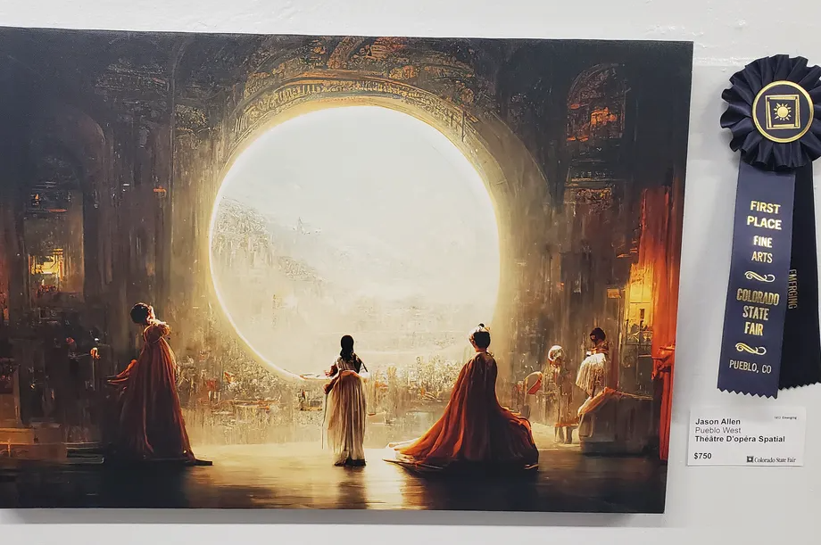
Copyright Review Board: Théâtre D’opéra Spatial (Sept. 5, 2023)
Notes:
Mr. Allen describes “input[ing] numerous revisions and text prompts at least 624 times” before producing the Midjourney Image, the steps in that process were ultimately dependent on how the Midjourney system processed Mr. Allen’s prompts. … It is the Office’s understanding that, because Midjourney does not treat text prompts as direct instructions, users may need to attempt hundreds of iterations before landing upon an image they find satisfactory.
The Board acknowledges that the process of prompting can involve creativity—after all, “some prompts may be sufficiently creative to be protected by copyright” as literary works. But that does not mean that providing text prompts to Midjourney “actually form[s]” the generated images. (See Thaler, the “key” to copyright protection is “[h]uman involvement in, and ultimate creative control over, the work at issue”). Instead, Mr. Allen is closer to the plaintiff in Kelley v. Chicago Park District who sought to claim copyright in a “living garden.”
The Board finds that the Work contains more than a de minimis amount of AI generated content, which must be disclaimed in an application for registration. Because Mr. Allen has refused to disclaim the material produced by AI, the Work cannot be registered as submitted.

Slide 17

THANKS
See also my book chapter: Weatherall, K, ‘IP and data, IP in data, IP as data’, in Damian Clifford, Jeannie Paterson and Kwan Ho Lau (Eds.), Data Rights and Private Law (2023, Hart Publishing)
Twin images used in this presentation come from: Carlini, Nicholas et al, ‘Extracting Training Data from Diffusion Models’ (No arXiv:2301.13188, arXiv, 30 January 2023) http://arxiv.org/abs/2301.13188
These slides are licensed under a Creative Commons Non-Commercial Licence (v 4.0 International). Terms here: https://creativecommons.org/licenses/by-nc/4.0/. You can use them for non-commercial purposes, including making changes, with attribution to the author, Kimberlee Weatherall (2024).
Contact for more information
Kimberlee Weatherall
kimberlee.weatherall@sydney.edu.au
https://www.sydney.edu.au/law/
https://www.admscentre.org.au/

