Slide 1
Critical Technologies
Emeritus Professor Hugh Bradlow, FTSE

Slide 2
Australian Government’s 7 “Critical Technology Fields”
Advanced manufacturing and materials technologies
AI technologies
Advanced information and communication technologies
Quantum technologies
Autonomous systems, robotics, positioning, timing and sensing
Biotechnologies
Clean energy generation and storage technologies

Slide 3
Misplaced Obsession with access network speed:
My “Law*” of Network Speed
There is a threshold access speed at which the requirements of the average individual user are satisfied
Speed
“Bradlow Threshold” for network speed
* Like all these so-called “Laws” this is more of an observation
Time
Speed requirement
Notes:
Corollary 1: Since video is the dominant traffic type the Bradlow Threshold is roughly proportional to the square of the diagonal of the screen size (i.e. the number of pixels on the screen)
Corollary 2: As devices and screen sizes change, the Bradlow Threshold will move up
Corollary 3: Once the network is capable of delivering the Bradlow Threshold, the focus is on capacity and throughput (i.e. Uncontended throughput capability)

Slide 4
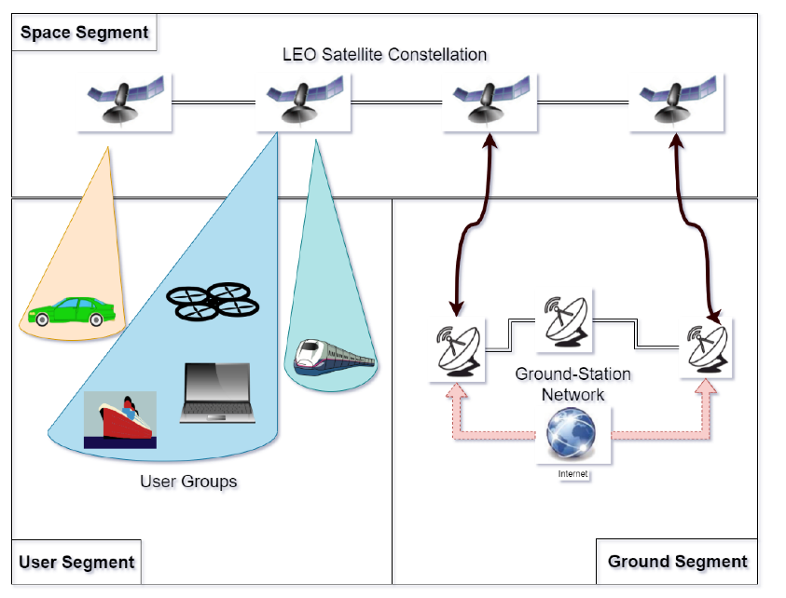
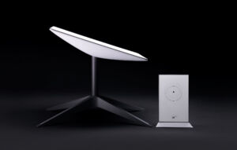


LEOs
Image from https://arstechnica.com/information-technology/2021/11/starlink-unveils-2nd-generation-satellite-dish-and-new-wi-fi-router/
Image from https://www.mdpi.com/1424-8220/22/4/1421
Notes:
Most constellations are bent pipes
inter-satellite links increase power requirements for the satellite
That means to get coverage you need to be within a radius of approximately 650km of a ground station (https://marinedatasolutions.com/starlink-faq/#:~:text=%E2%AD%90%20How%20does%20Starlink%20work,station%20is%20about%20400%20miles.)
Spectrum
Avoiding geo usage
Ownership in each country – either satellite provider must buy spectrum or do a deal with with an operator
Mobile handset use
Add femtocell capability (as well as WiFi) to user terminal – requires a deal with an operator for
authentication of devices onto femtocell and
call management
Handsets connected via LEO
Connected via WiFi and VPN to remote call manager: no different to any other Internet access
No mobility management (i.e. incoming calls are only when attached to the Internet)
Connected via femtocell to remote operator: no different from any other mobile roaming

Slide 5
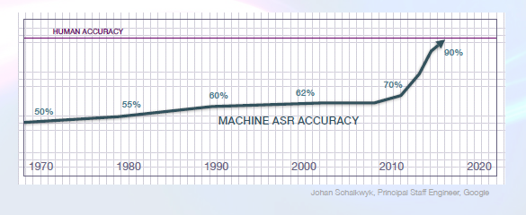
Machine Learning

Slide 6
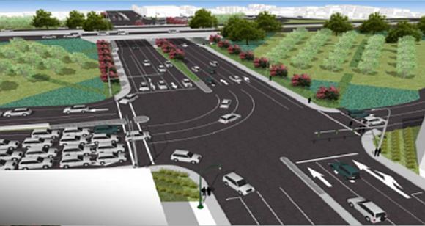
Machine vision
Traffic violation
Excessive waiting: Modify Traffic light algorithm
This Photo by Unknown Author is licensed under CC BY-NC-ND
Stolen Vehicle
Notes:
E.g. Verizon CES presentation including Skyward.io (~35 min into https://youtu.be/ljbUJsMV_Sg)
Also enables real-time BVLOS where the operator can see what the drone is doing and control in real-time

Slide 7
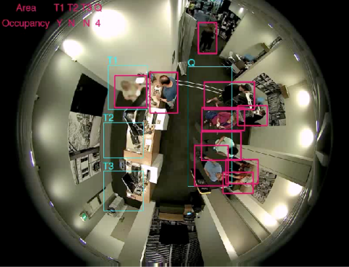
Machine vision: automated time and motion studies

Slide 8
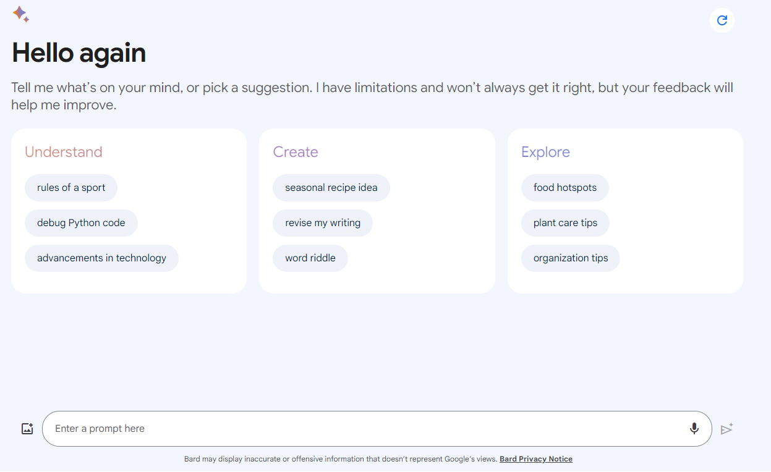
Generative AI: Large Language Models

