Slide 1
Monetary policy, fiscal policy and inflation Parliamentary library
Monetary policy, fiscal policy and inflation
Parliamentary library
Rene´e Fry-McKibbin
Centre for Applied Macroeconomic Analysis Australian National University
May 5, 2023

Slide 2
Monetary policy, fiscal policy and inflation Parliamentary library
Introduction
Overview
▶ Objectives of monetary and fiscal policy
▶ Determinants of the price level (and inflation)
▶ Current policy environment
▶ How monetary policy works
▶ Fiscal policy contributions
▶ Recommendations on monetary-fiscal policy interactions

Slide 3
Monetary policy, fiscal policy and inflation Parliamentary library
Objectives
Objectives of monetary and fiscal policy - both affect inflation and growth
▶ Monetary policy objectives
▶ stability of the currency
▶ Modern interpretation is price stability
▶ Measured through inflation (change in prices)
▶ full employment
▶ economic prosperity and welfare of the Australian people
▶ MP influences economic activity by adjusting the interest rate
▶ Fiscal policy objectives
▶ maintaining and improving the performance of the economy
▶ security of the community
▶ provision of public services
▶ distribution of income and opportunity
▶ preserving fiscal sustainability
▶ FP influences economic activity through tax and transfer payments

Slide 4
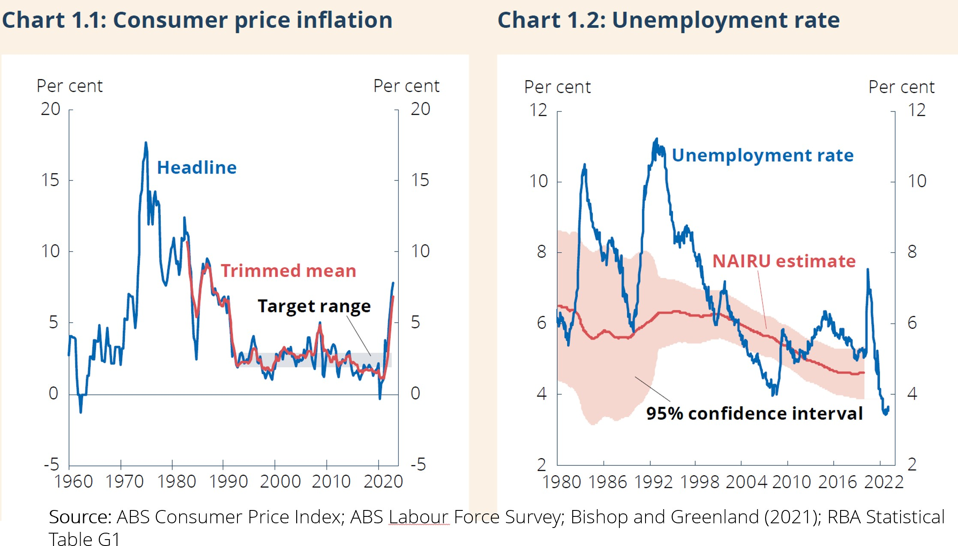
Monetary policy, fiscal policy and inflation Parliamentary library
Objectives
Consumer price inflation and employment

Slide 5
Monetary policy, fiscal policy and inflation Parliamentary library
Objectives
MP and FP interactions
MP and FP can be reinforcing or opposing
▶ Example 1: Global financial crisis and COVID-19 pandemic
▶ MP and FP both added stimuli to the economy
▶ Example 2: After the unwinding of the commodities boom
▶ MP stimulatory
▶ FP contractionary as the government was restoring its balance sheet

Slide 6
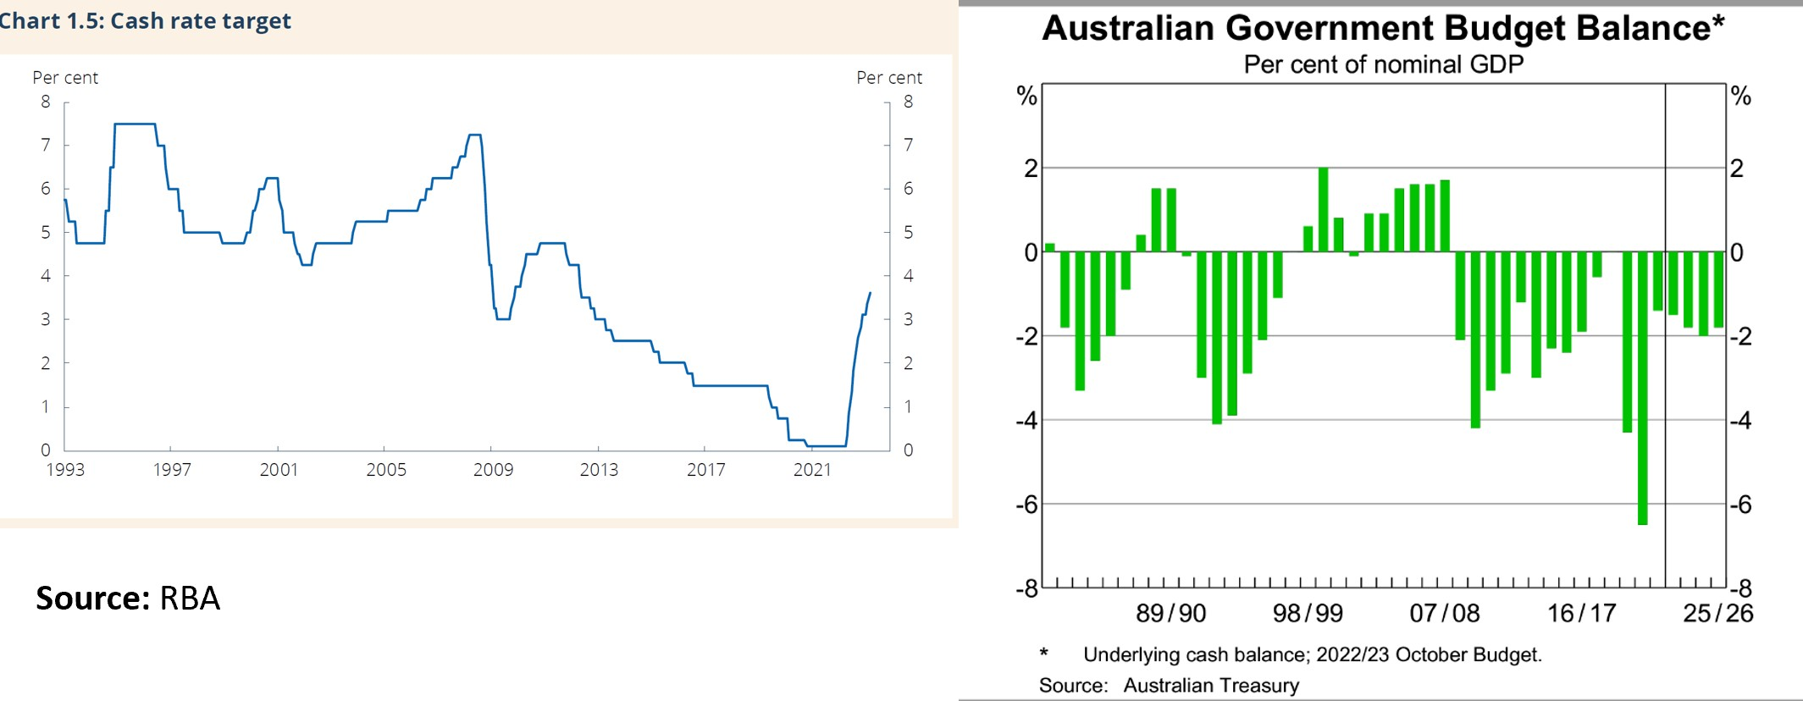
Monetary policy, fiscal policy and inflation Parliamentary library
Objectives
Cash interest rate and government budget balance

Slide 7
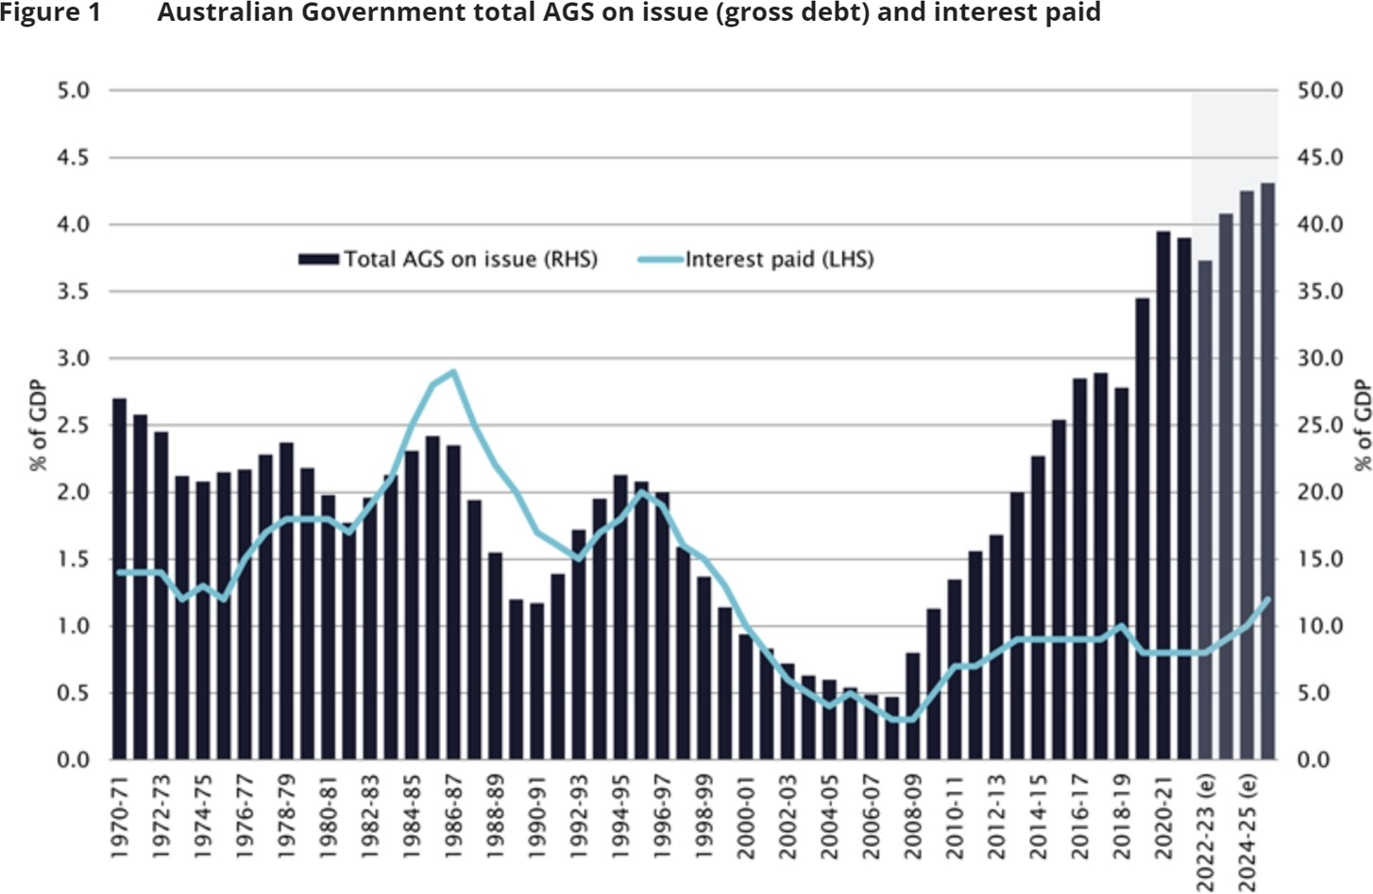
Monetary policy, fiscal policy and inflation Parliamentary library
Objectives
Australian government securities

Slide 8
Monetary policy, fiscal policy and inflation Parliamentary library
Determinants of inflation
Demand and supply contributors to inflation
▶ Demand side
▶ large increase in quantity demanded of goods and services
▶ increase in prices of goods and services (inflation)
▶ reflects a strong economy
▶ Supply side
▶ large fall in quantity supplied of goods and services
▶ increase in prices of goods and services (inflation)
▶ examples include natural disasters that damage agriculture, large increases in the price of energy, disruptions to supply chains
▶ other factors might include the cost of production, such as labour and raw materials and changes in technology that affect production efficiency.

Slide 9
Monetary policy, fiscal policy and inflation Parliamentary library
Current policy environment
Current policy environment
▶ MP has had responsibility for managing the macroeconomic cycle
▶ Fiscal and regulatory policies have focused on other priorities
▶ except automatic stabilisers
▶ and stimulus packages
▶ Recent increases in interest rates, inflation and a strong labour market is raising questions on the best approach to inflation
▶ is the interest rate the only way?
▶ what can fiscal policy do?
▶ Elements to consider:
▶ nature of current inflation
▶ understand how monetary and fiscal policies work

Slide 10
Monetary policy, fiscal policy and inflation Parliamentary library
Current policy environment
Nature of inflation
▶ Supply disruptions
▶ Ukraine
▶ supply chain
▶ extreme weather
▶ RBA estimate is 1/3-3/4 of inflation
▶ Strong demand
▶ changes in consumption patterns
▶ significant fiscal and monetary policy stimulus
▶ RBA raised interest rates to moderate demand and control inflation expectations

Slide 11
Monetary policy, fiscal policy and inflation Parliamentary library
How monetary policy works
How monetary policy works
▶ Higher interest rates overall reduce demand and inflation
▶ curb household spending
▶ increase cost of new and existing borrowing
▶ reduce disposable income
▶ increase the return to savers
▶ lower asset prices
▶ business raise prices by less
▶ businesses employ fewer workers
▶ reduce wage growth
▶ exchange rate becomes more expensive (perhaps not now)
▶ reduces exports
▶ less inflation from overseas

Slide 12
Monetary policy, fiscal policy and inflation Parliamentary library
How monetary policy works
How monetary policy works
▶ Cannot address supply disruptions directly
▶ ‘Look through’ temporary disruptions to supply
▶ Current inflation is being driven by strong demand as well as supply disruptions
▶ Recent supply disruptions are persistent - concerns of high inflation expectations
▶ Distributive effects
▶ benefit savers over borrowers
▶ disadvantage some workers for the benefit of Australians as a whole
▶ low and stable inflation contributes to growth in incomes and employment
▶ reduces economic instability for those that can least afford it
12 / 15

Slide 13
Monetary policy, fiscal policy and inflation Parliamentary library
Fiscal policy
Fiscal policy
▶ Fiscal (or regulatory) policy better to address distributional issues
▶ tax and transfers
▶ regulations to support market competition
▶ financial regulation
▶ supply chain resilience
▶ Limitations of fiscal policy
▶ not be as nimble as monetary policy
▶ may affect competition or the efficient operation of the economy
▶ not as credible
▶ Important to understand policy interactions to ensure the best for price stability, full employment and fairness

Slide 14
Monetary policy, fiscal policy and inflation Parliamentary library
Fiscal policy
Other considerations
▶ Cash rate changes also affect fiscal policy outcomes through
▶ interest payments on government debt
▶ tax revenue linked to economic growth
▶ debt sustainability
▶ Fiscal policy also affects inflation outcomes
▶ Instability of government finances can raise concerns of inflation and debt monetisation
▶ Wealth effects from government debt
▶ More work being done to understand interactions
.
▶ RBA dividend to government from earnings

Slide 15
Monetary policy, fiscal policy and inflation Parliamentary library
Review recommendations on interactions
Interaction of monetary and fiscal policy - Review recommendations
▶ statement between RBA board and Treasurer - acknowledge the importance of both monetary policy and fiscal policy for macroeconomic outcomes
▶ share information about the economic outlook, risks and policy constraints
▶ work together to analyse the impacts of monetary policy decisions on fiscal policy and vice-versa
▶ jointly develop scenario analysis
▶ acknowledge that fiscal policy may have a larger role in some circumstances, for example when the cash rate is at its effective lower bound
▶ develop an Australian Macroeconomic Policy Research Program
▶ agree on a framework for the use of additional monetary policy tools in the future especially when have implications for the budget
▶ retain Secretary to Treasurer on RBA board

